Slide 1
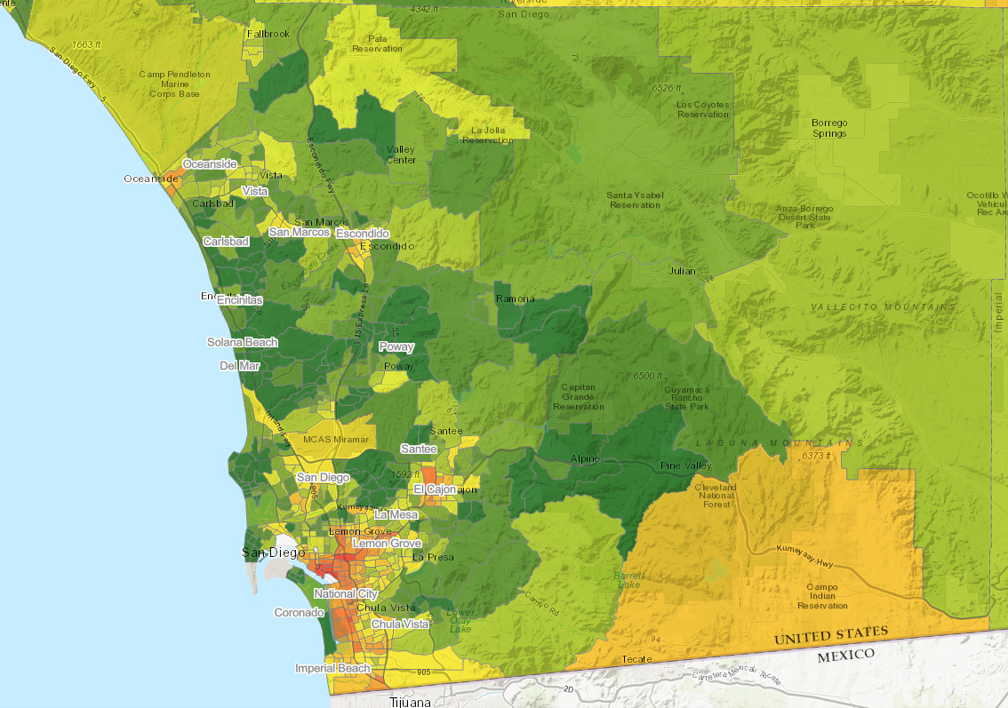
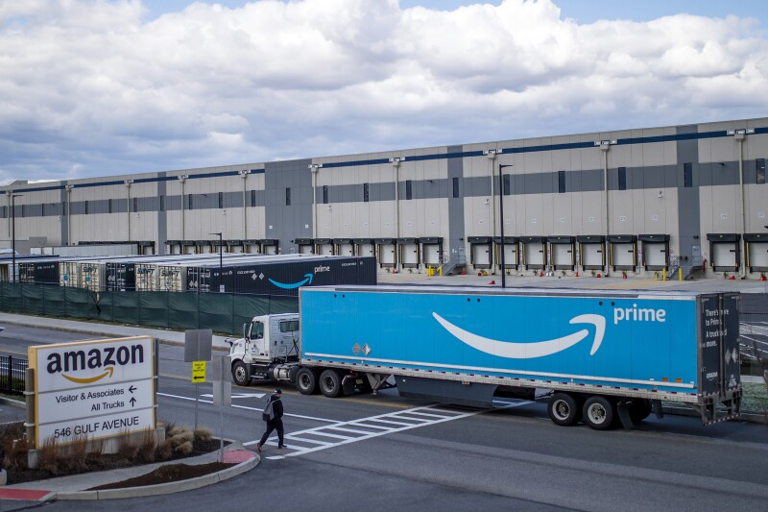
SD County Indirect Source Rule?
Seeking to Understand How Warehouses Affect Mobile Source Air Pollution in San Diego- Past, Present, and Future

Slide 2
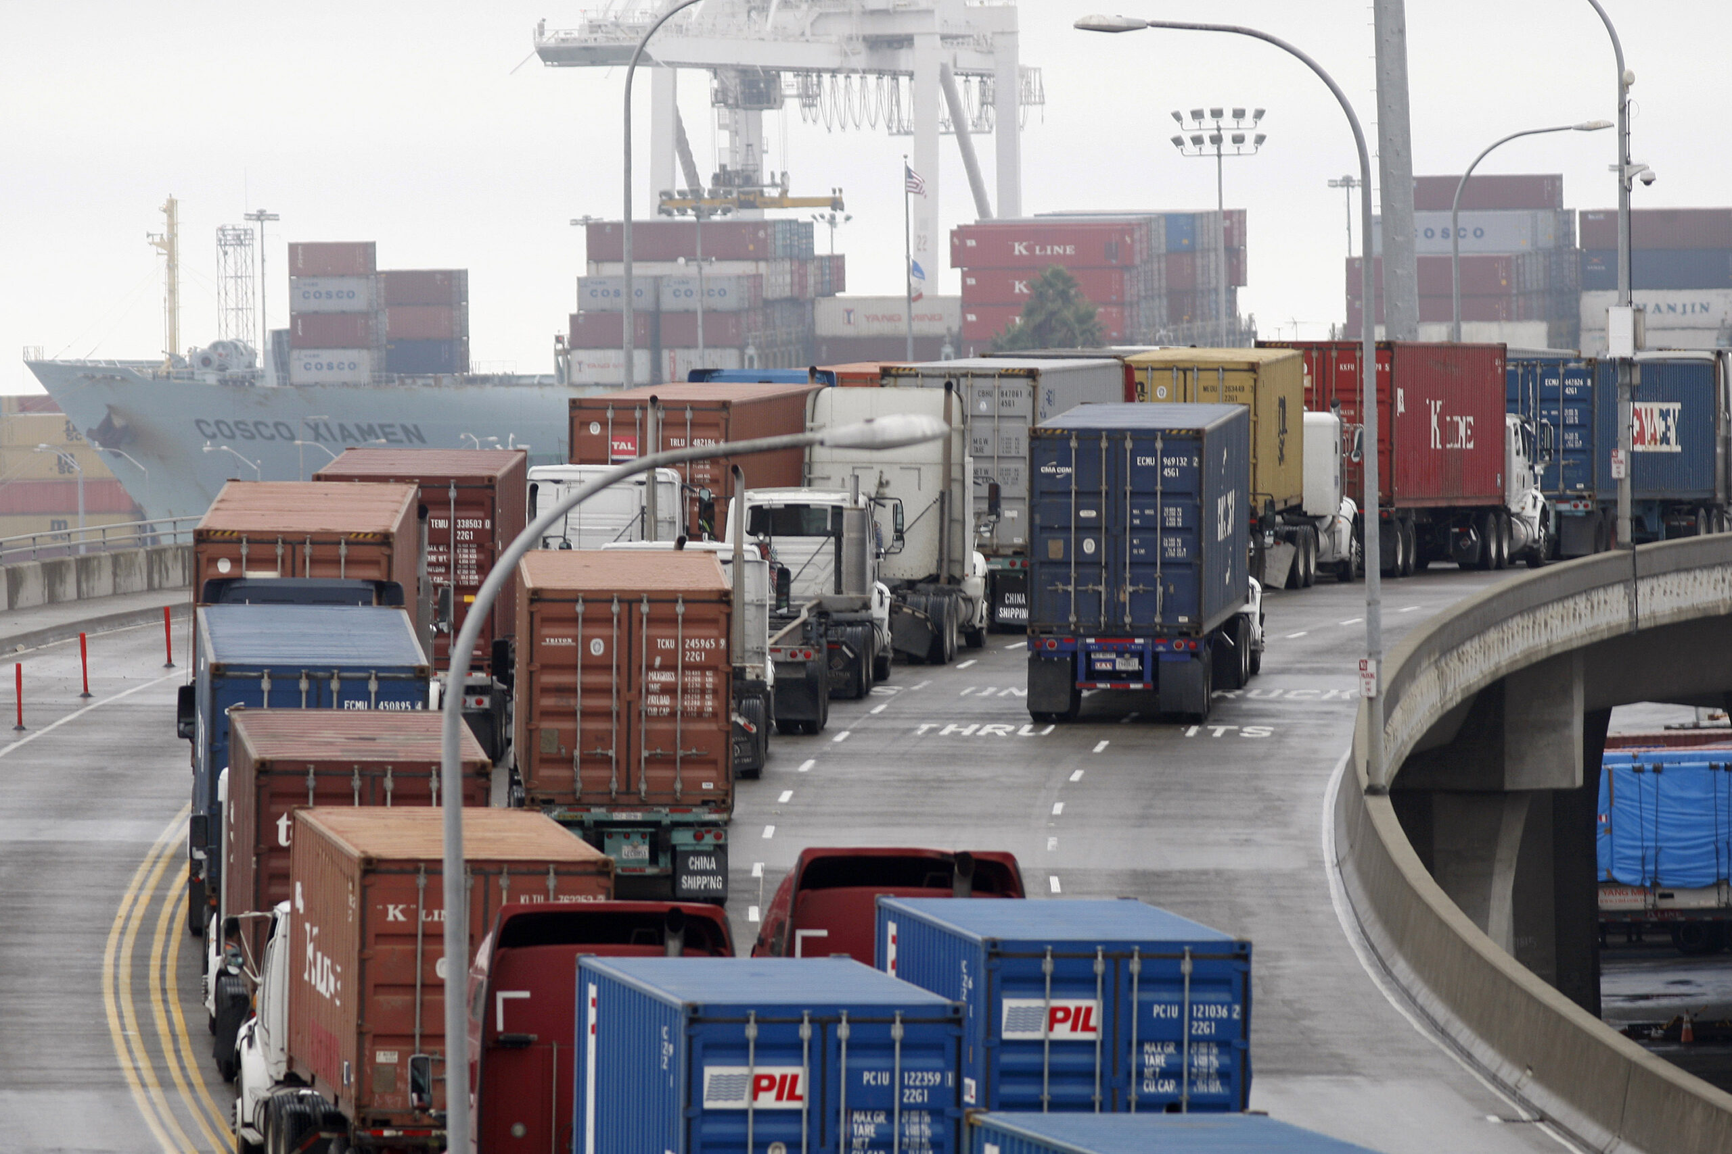
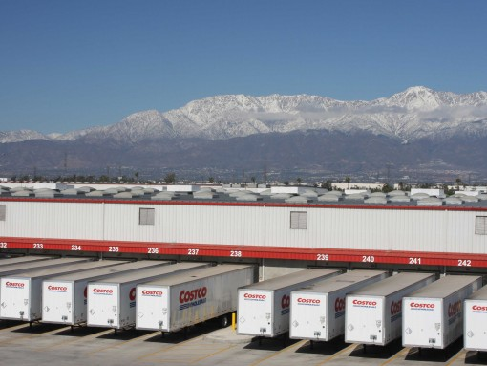
Presumption:
Introduction
Assembly Bill 423
Orders APCD to consider adopting an Indirect Source Rule
Target: Stationary Sources that attract Mobile Sources of air pollutants(DPM and NOx)
  Ports, Warehouses, and Distribution Centers
Warehouses are major contributors to mobile source pollution in SD County
Bottom Line Up-Front:
Truck volumes in SD County areas w/ warehouses do not appear to be higher than other high traffic/DPM affected areas in SD County
Models show steady “floor” for overall PM 2.5 emissions as electric transition continues
El Cajon/Escondido to benefit most from electrification (NOx and ozone reductions)

Slide 3




Analysis Problem Statement:
Many Models and Data Sources
New geospatial models and datasets help to facilitate meta-analyses
Known datasets for
  Traffic model volumes
  Vehicle traffic types
  Emissions modeling
CARB, CALTRANS, OEHHA, City of San Diego
Can a connection be observed between warehouses, truck volume, and DPM in San Diego Census Tracts?
Follow-up Question:
Would additional regulation on warehouse facilities provide a material improvement to emissions in Disadvantaged Communities?

Slide 4
Analysis Data Sources
CalEnviroScreen 4.0
https://oehha.ca.gov/media/downloads/calenviroscreen/document/calenviroscreen40resultsdatadictionaryf2021.zip
Annual Average Daily Truck Traffic (AADT) , 2016, 2021, and 2022 CalTrans
  https://dot.ca.gov/-/media/dot-media/programs/traffic-operations/documents/census/aadt/2016_truck_aadtt_xlsx.xlsx
  https://dot.ca.gov/-/media/dot-media/programs/traffic-operations/documents/census/2021/2021-truck-aadtt-ca.xlsx
  https://dot.ca.gov/-/media/dot-media/programs/traffic-operations/documents/census/2022/2022-truck-aadt.xlsx
California Air Resources Board Emission Factor (EMFAC 2021) Model
  EMFAC (ca.gov)
California Air Resources Board California Emissions Projection Analysis Model (CEPAM)
CEPAM2019v1.03 - Standard Emission Tool | California Air Resources Board
Google Earth, October 2023
  Informed by native San Diegan
    Lives in Chula Vista
    Worked in Kearney Mesa, Oceanside, Miramar, Poway, National City, and Otay Mesa

Slide 5
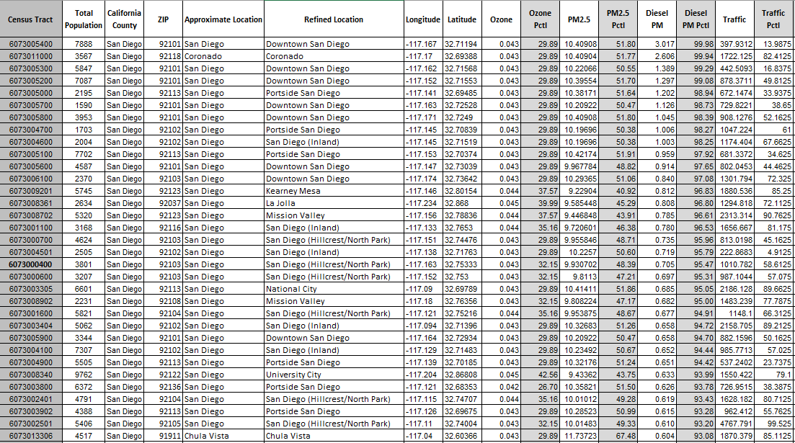
Methodology
1) Reviewed CalEnviroScreen Census Tract Data
Census tracts include ZIP Code, Lat/Long, and Approximate Location
Filtered for San Diego County Locations
Viewed points on Maps, added neighborhoods for context
  Example: Census Tract 6073005000 is listed as San Diego, but refined to Portside San Diego
Calculated Average DPM and Traffic % Score by Refined Location
NOTE: DPM and Traffic data in CES 4.0 are from 2016….

Slide 6
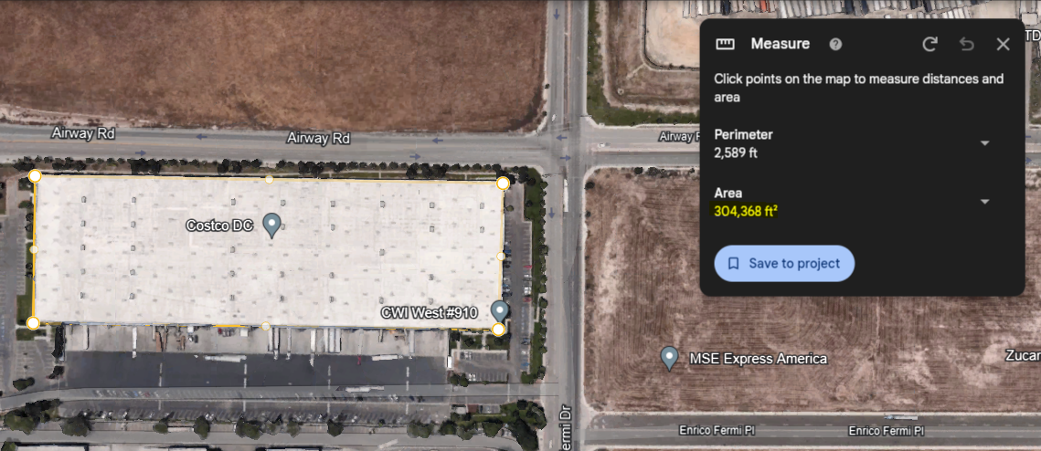
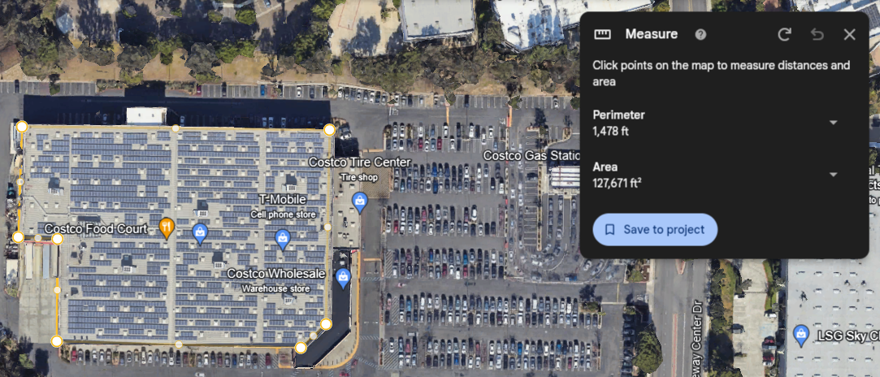
Methodology
Warehouse – Costco Distribution Center
2) Identified Warehouse Spaces in San Diego County
Aerial review on Google Earth
  2016 Aerial Imagery
  Current (October 2023)
Facilities identified as defined in SCAQMD Rule 2305
  “A building that stores cargo, goods, or products on a short- or long-term basis for later distribution for businesses and/or retail customers.”
Measure Property Area in SF
  Acknowledge that not all area is warehouse space
Track Facility Name, Total Area, and Location in SD County
300+ Facilities identified
  Acknowledge that dataset is not exhaustive, but representative
Not a Warehouse – Costco Retail Store

Slide 7
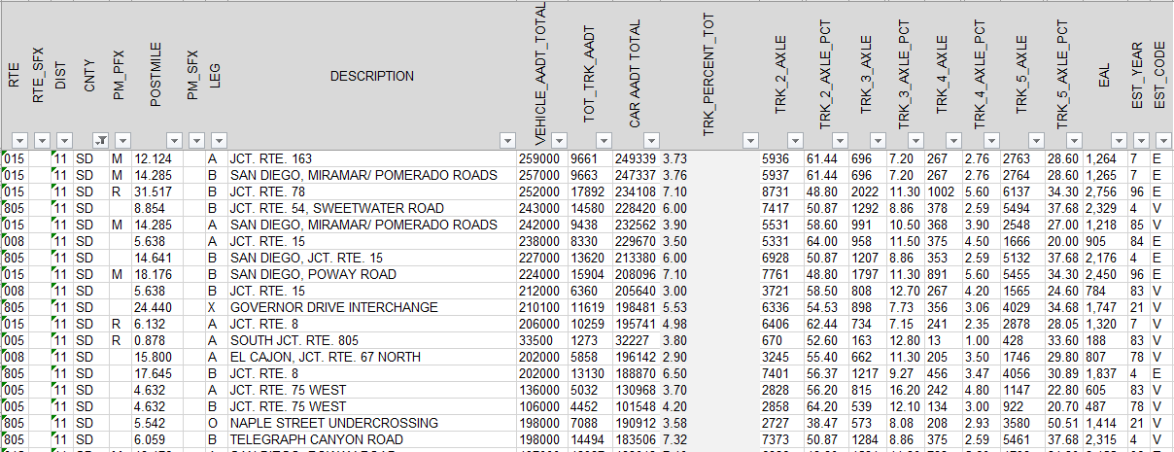
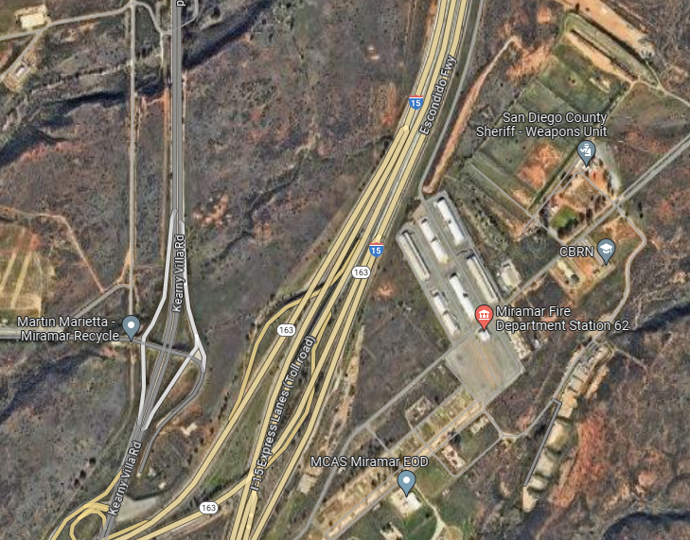
Methodology
3) Reviewed CalTrans Annual Average Daily Truck Volumes
For each major freeway junction
  Total Vehicles on road
    2, 3, 4, 5 axle Trucks
    Personal Vehicles
Assigned “Refined Location” to list of junctions
Matched CalEnviroscreen 4.0 and CalTrans datasets
Limitation: Data not available for all exits/junctions – major arteries and crossings

Slide 8
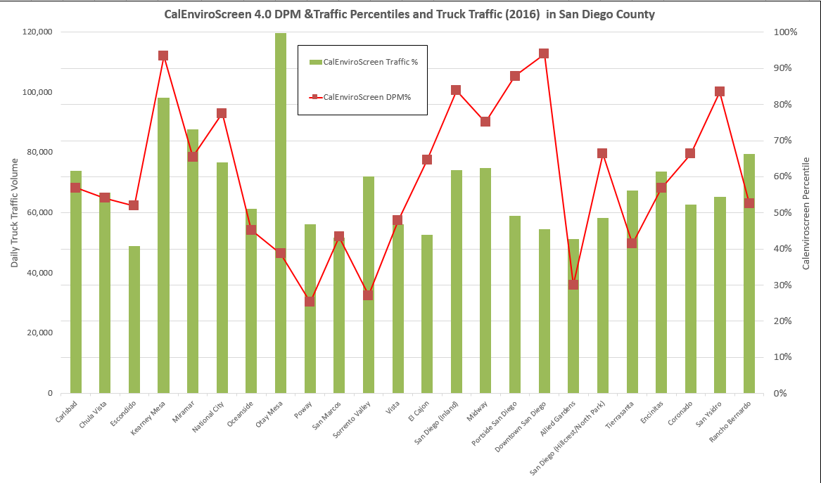
CalEnviroScreen 4.0 - DPM and Traffic

Slide 9
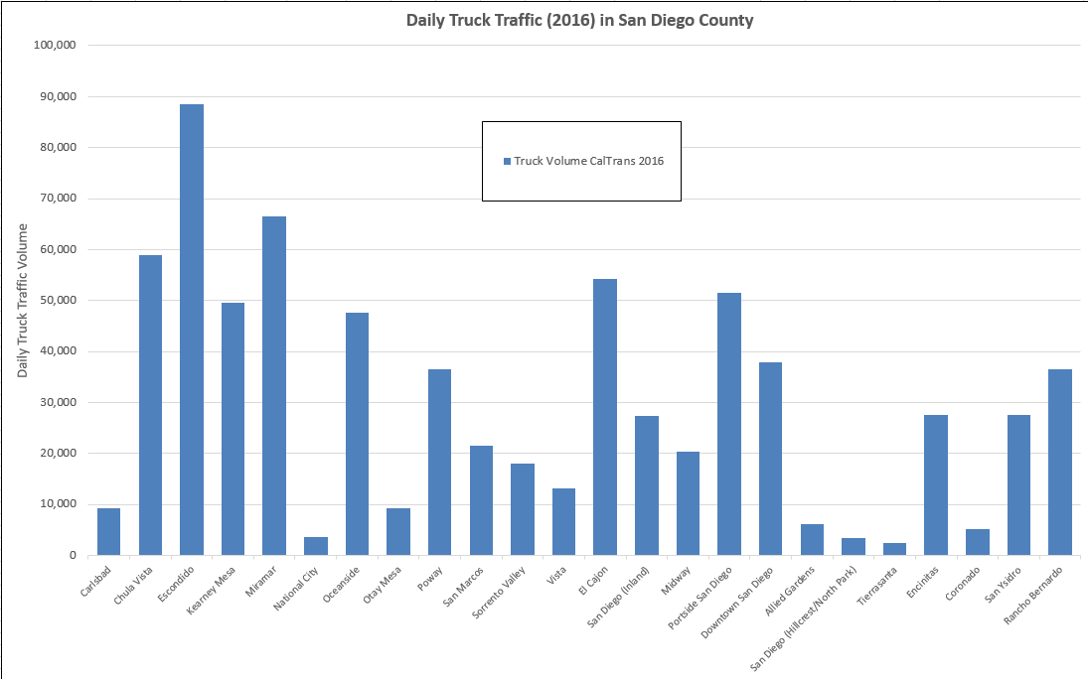
Daily Truck Trips in SD County

Slide 10
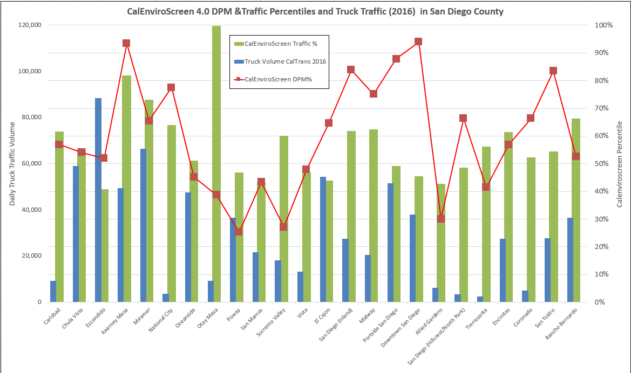
CalEnviroScreen and CalTrans Truck Traffic

Slide 11
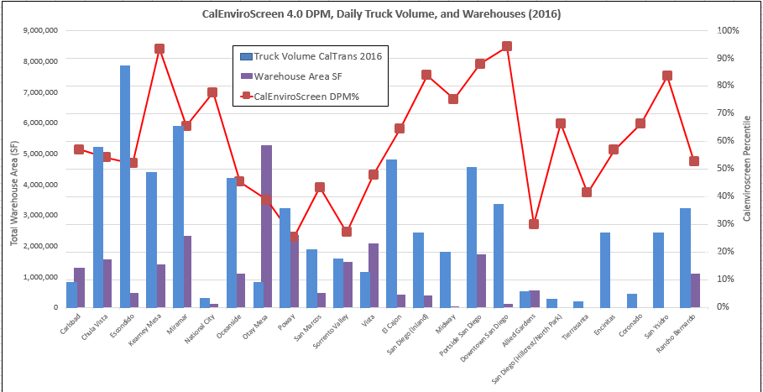
Warehouses, Truck Traffic, and DPM Percentiles (2016)

Slide 12
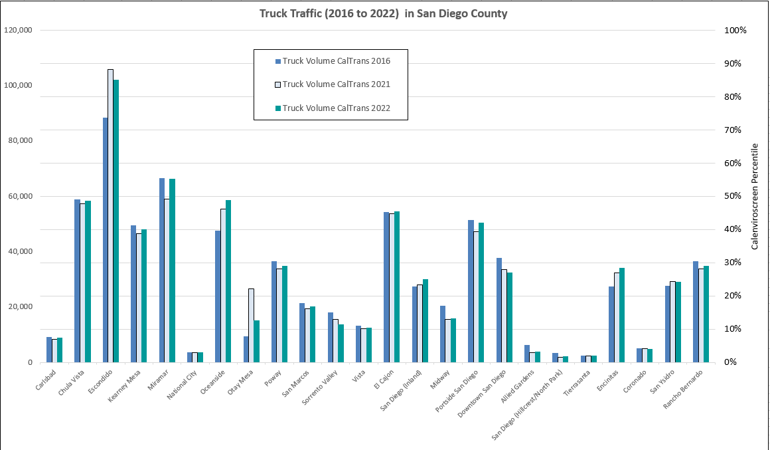
How has Truck Traffic Changed Over Time?
Consolidation to bigger trucks
Consolidation to bigger trucks
Consolidation to bigger trucks

Slide 13
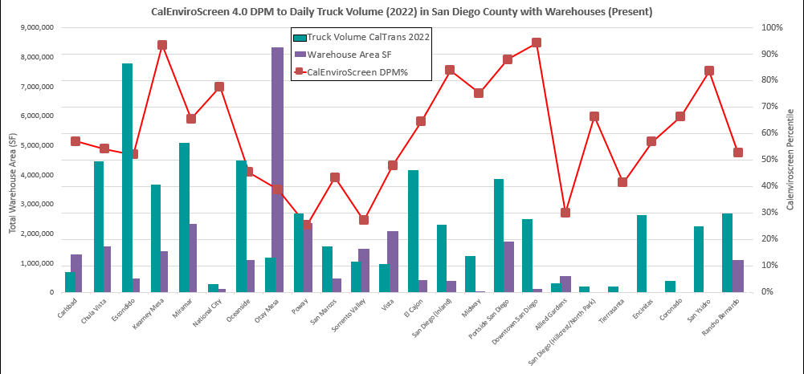
Warehouses, Truck Traffic, and DPM Percentiles (Current)
2023
2016
Need more current data

Slide 14
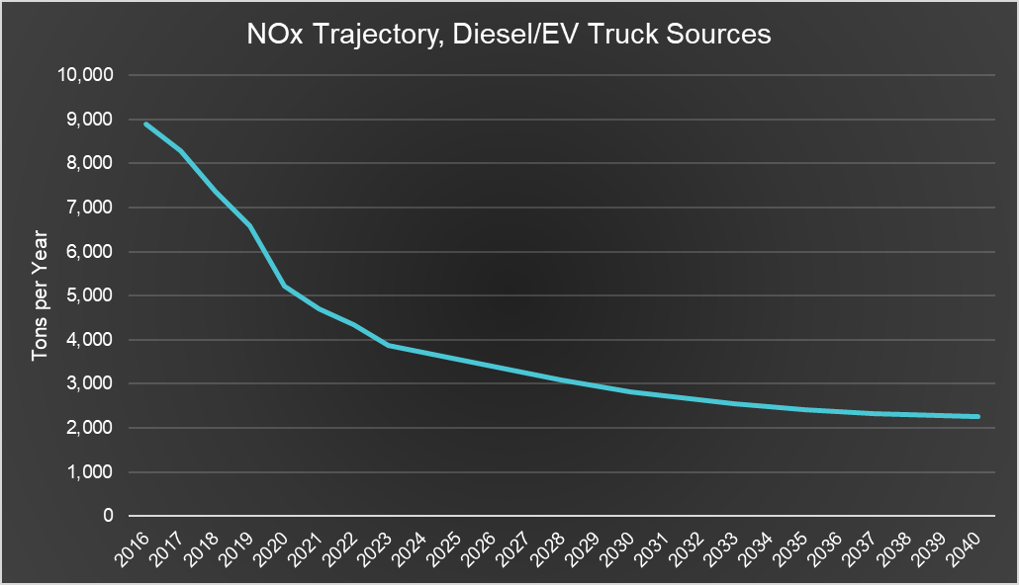
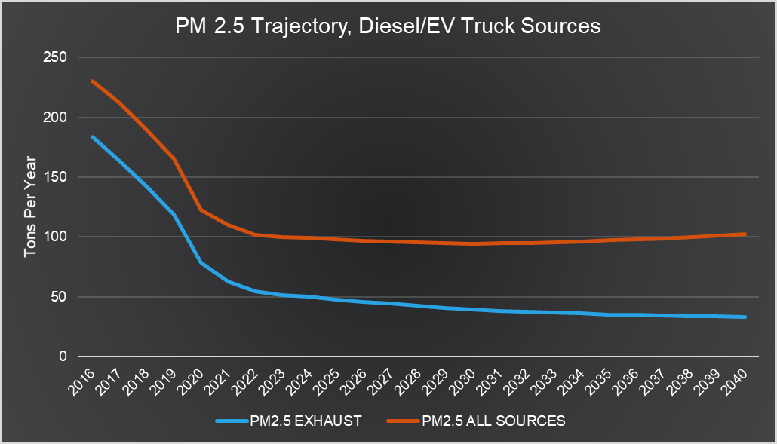

Current/Upcoming Regulations for Diesel Vehicles
EMFAC Model Projections
Low Carbon Fuel Standard
EPA Heavy-Duty Engine and Vehicle Standards
Clean Truck Check / Advanced Clean Trucks
Advanced Clean Fleets Rule (Not yet modeled)
We are here
We are here
What is the trajectory?
CARB’s EMFAC(2021) Model accounts for:
Expanding EV population
Increase in overall VMT
Emissions:
  Tail-pipe exhaust
  Tire wear
  Brake wear
    Regenerative braking for EVs (50%)
Note: EMFAC does not account for road wear emissions

Slide 15
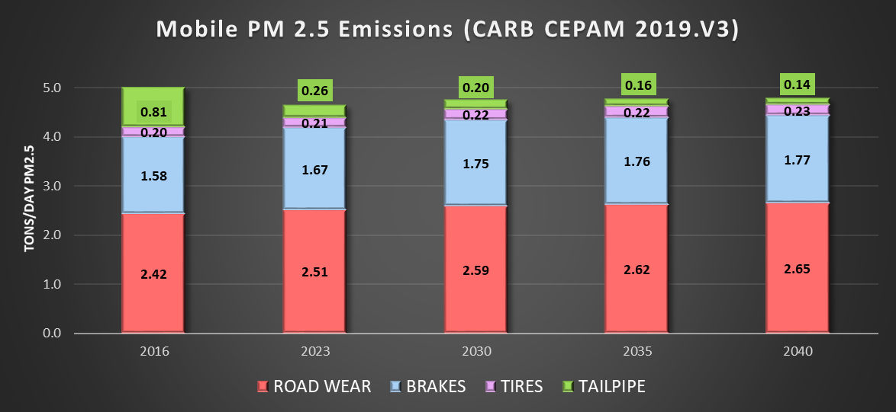
Total Mobile PM 2.5 Emissions
EMFAC (previous slide) – does not include road wear
CEPAM (Also CARB Model)- includes all forms
  Mobile, Stationary, Off-road, Area
Exhaust emissions continue to decline
Tires, brakes, road wear increase
  Aging roads and infrastructure
  Heavier vehicles
  Increased VMT

Slide 16
Questions/Thoughts to Consider
What proportion of trucks in San Diego would an ISR capture?
High truck traffic areas in San Diego County do not correlate strongly with areas where warehouses are located
How much reduction in air pollution could we expect from an ISR?
Overall PM 2.5 projected to stay constant throughout transition
NOx – biggest reduction, ~40% by 2040 as modeled before ACF and an ISR
  ISR may accelerate EV adoption – keep infrastructure & supply chain risks in mind L
Would an ISR help the communities with the worst air quality?
NOx (ozone) reductions - benefit 28 out 184 Census Tracts with worse than average ozone pollution
Would an ISR and/or targeted incentive program for businesses/warehouses with high Ozone Census Tracts be feasible?
El Cajon (13 Census Tracts)
Escondido (10 Census Tracts)
We need to better communicate the overall risk from PM 2.5 to San Diego communities
PM 2.5 from brake dust, road wear, and tires also hazardous (CARB, Medical Research Council, UK)
Would electrification dramatically reduce health risk?

Slide 17
Thank You!
Comments?
Suggestions?

