Slide 1
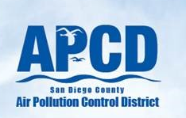
Draft Incident Response Plan Update
APCD Governing Board Meeting
Agenda Item 3
November 4, 2021 1:30pm
Actualización sobre el Borrador del Plan de Respuesta a Incidentes
Reunión de la Mesa Directiva del APCD
Tema 3 de la Agenda
4 de noviembre, 2021 1:30pm
Notes:
DOMINGO:
Good afternoon Chair Vargas, members of the Board and members of the public. My name is Domingo Vigil, Deputy Director with the San Diego County Air Pollution Control District. With me is my colleague Dr. David Sodeman, Chief of our Monitoring and Technical Services Division. Today we will provide an update on APCD’s Draft Incident Response Plan. The Draft Plan outlines APCD’s response to major releases of air contaminants that may cause adverse health consequences to the public and result in a multi-agency response. The plan also explains how APCD will work within the Incident Command System to minimize public exposure to air contaminants using APCD’s area of expertise. I will now turn it over to Dr. Sodeman.

Slide 2
Presentation Outline
Resumen de la presentación
Unified Command Structure
Incident Notification Procedures
Current Monitoring Equipment
Instrument Characteristics
Communication Strategy
What Can the Public Do?
Public Workshop Response
Estructura de Comando Unificado
Procedimientos de notificación de incidentes
Equipo de monitoreo actual
Características de los instrumentos
Estrategia de comunicación
¿Qué puede hacer el público?
Respuestas del taller público
2
Notes:
Thank you, Domingo. Good afternoon Chair Vargas, Board members and the public. Today, we will review the Incident or Unified Command Structure, the incident notification procedures, APCD current monitoring capabilities, instrument characteristics that must be considered when enhancing our response capabilities, our communication strategy during an Incident, actions the public can take to prepare for and stay informed during an incident, and a summary of the workshop feedback.

Slide 3
What is an Incident?
¿Qué es un incidente?
Incident definition:
  any release of air contaminants into the environment that may cause adverse health consequences to the public and results in a multi-agency response
Definición de incidente::
  cualquier liberación de contaminantes del aire al medio ambiente que pueda causar consecuencias adversas para la salud del público y que resulte en una respuesta de múltiples agencias
Examples of Incidents
  Major spills
  2020 Bonhomme Richard Vessel Fire
  Wildfires in 2003, 2007, and 2015
  Immediate Threat: call 9-1-1
Examples of non-Incidents
  Smaller structural and brush fires
  Dust, Odor, or Asbestos Complaints
    APCD Complaint Line: 858-586-2650
Ejemplos de incidentes:
  Derrames grandes
  Incendio del buque Bonhomme Richard 2020
  Incendios forestales en 2003, 2007 y 2015
  Amenaza inmediata: llame al 9-1-1
Ejemplos de no incidents
  Incendios más pequeños de estructuras y de matorrales
  Quejas de polvo, olor o asbestos
    Línea de quejas de APCD: 858-586-2650
3
Notes:
First, let’s discuss what is an Incident. APCD defines an incident as “any release of air contaminants into the environment that may cause adverse health consequences to the public and results in a multi-agency response.” Examples of past incidents include major spills, last years Navy Ship Fire, and the various large wildfires that occurred in our region in 2003, 2007, and 2015. Examples of non-Incidents includes dust, nuisance odors, or asbestos complaints and smaller structural and brush fires. For air quality complaints related to dust and odors, members of the public can call our Complaint Line.
If a member of the public happens to come across an incident and there is an immediate heath threat, please call 9-1-1 and not APCD. On a later slide, we will address how APCD is informed of an incident.

Slide 4
Unified Command Structure
Estructura de mando unificado
Unified Commander
Comandante unificado
Public Information Officer
Oficial de información pública
Unified Command
Comando Unificado
Safety Officer
Oficial de seguridad
Liaison Officer
Oficial de enlace
Operations
Operaciones
Planning
Planificación
Logistics
Logística
Finance
Finanzas
Public Health Assessment Unit
Unidad de Evaluación de Salud Pública
Air Districts
Distritos de aire
Public Health Agencies
Agencias de salud pública
4
Notes:
Go SLOW
We will now discuss the Unified Command Structure. When an Incident occurs, an Incident or Unified Command is set up. The purpose of the Unified Command is to have the various agencies that are responding to the incident work in harmony, cohesively, and cooperatively with one another. The Unified command is lead by, two or more Unified Commanders with assistance from Public Information Officers, Safety Officers, and Liaison Officers. The Unified Command oversees four main groups – Operations, Planning, Logistics, and Finance. Air Districts, along with Public Health Agencies, are organized into the Public Health Assessment unit within the Planning Group.
Who leads the Unified Command depends on where the incident originates. It will typically be either a Federal Agency or the County of San Diego’s Office of Emergency Services. The Unified Commander is responsible for bringing in the necessary agencies to respond to the incident, including APCD. The Unified Command will be responsible for the initial notification to the public regarding the incident and how to protect themselves. I would like to point out that there are no Incidents in which APCD would be the lead agency. In every Incident, APCD would be a supporting agency.

Slide 5
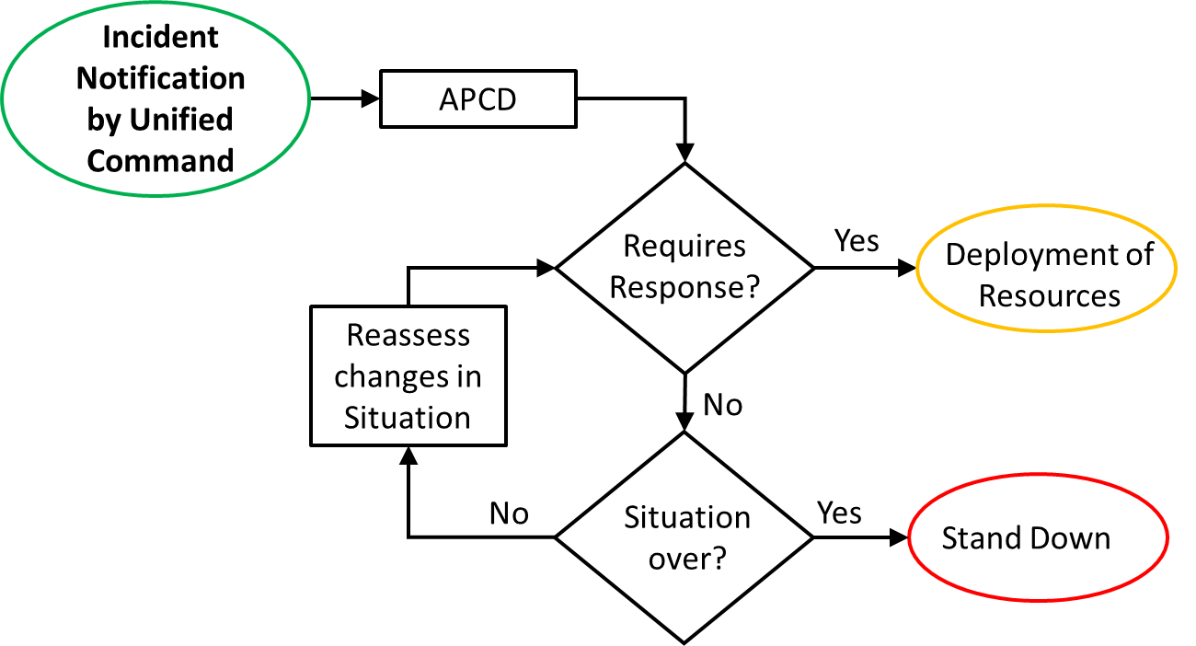
APCD Notification and Role in a Unified Command
Notificación y función de APCD en un Comando Unificado
Notificación de incidentes por comando unido
APCD
¿Requiere respuesta?
Si
Despliegue
Reevaluar los cambios
No
¿Se acabó la situación?
No
Si
Retirarse
5
Notes:
APCD executive management is available 24/7 to be notified by the Unified Command that an incident has occurred. APCD executive management will notify the appropriate staff. The staff will evaluate the incident information to determine what our response should be and what resources, if any, should be deployed. If the incident doesn’t rise to that level, staff will continue to assess the incident for any changes and will reevaluate if deployment of resources are needed. APCD will be in close contact with the unified command in coordinating public messaging.

Slide 6
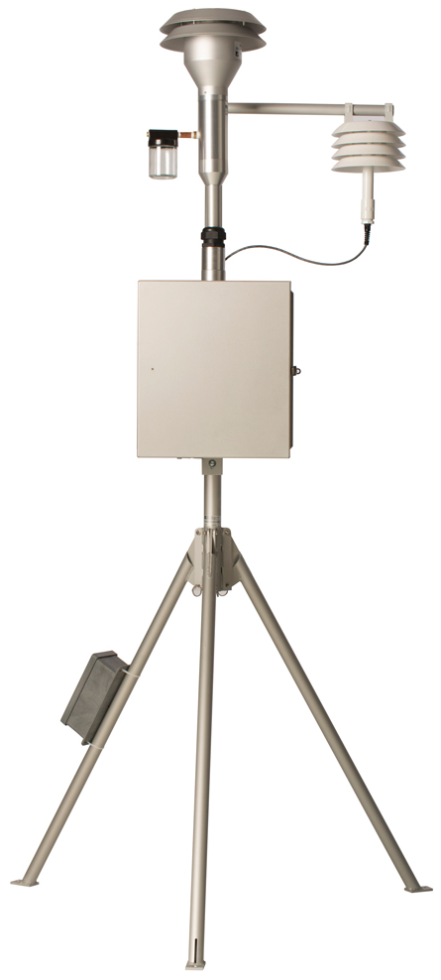
Deployment of Samplers
Despliegue de muestreadores
Decide general sampling locations
Does the equipment require plug-in power?
Does the equipment need to be secured against theft/ vandalism?
How big is the equipment?
Do we have agreements in place with property owners?
Steps once on site
  Power, Install, Calibration, Communication set up
This process takes at least 5-hours
Decidir las ubicaciones generales de muestreo
¿El equipo requiere conexión de energía eléctrica?
¿Es necesario asegurar el equipo contra robo/ vandalismo?
¿Qué tan grande es el equipo?
¿Tenemos acuerdos con los propietarios del sitio?
Pasos una vez en el sitio
  Encender, instalación, calibración, configuración de comunicación
Este proceso toma al menos 5 horas.
6.5 Feet Tall
40 pounds
6.5 pies de alto
40 libras
6
Notes:
Each incident is unique and the deployment of resources must be decided on a case-by-case basis. Once the decision is made to deploy ambient air monitoring, several factors must be considered and decided on. Some of those considerations are listed on this slide. This entire process - deciding to deploy resources to point where staff have data available – will take at least 5 hours, even longer if it is after-hours. I would like to point out that APCD staff are not trained or properly equipped with safety gear to entire the ‘hot zone.’ The hot zone is also called the exclusion zone as non-first responders are not allowed in this area.

Slide 7
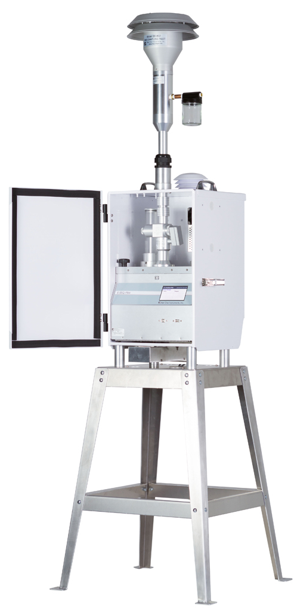
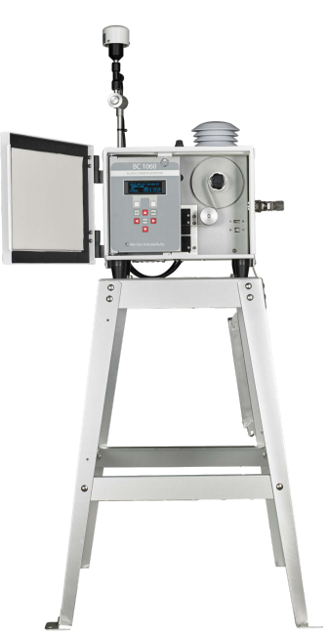
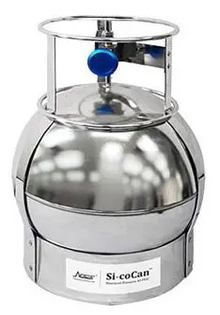
Current Equipment
Equipo actual
Existing Monitoring Stations
Hourly PM2.5
Hourly Black Carbon
  surrogate for Diesel PM
Lab based analysis for metals and toxic volatile organic compounds
Interagency assistance from CARB or EPA Region 9
Estaciones de monitoreo existentes
PM2.5 por hora
Carbono negro por hora
  Sustituto de Diesel PM
Análisis de laboratorio para metales y compuestos orgánicos volátiles tóxicos
Asistencia interinstitucional de CARB o EPA Región 9
6.5 Feet Tall
55 pounds
6.5 pies de alto
55 libras
6.5 Feet Tall
40 pounds
5 Feet Tall
45 pounds
1.5 Feet Tall
2 pounds
6.5 pies de alto
40 libras
5 pies de alto
45 libras
1.5 pies de alto
2 libras
7
Notes:
What are APCD current monitoring capabilities? We have our regional and community-based monitoring locations throughout the county with a wide range of instruments measuring many different pollutants. We will utilize any and all of those appropriate sites during an incident. We also have portable equipment, as shown on the slide. Our current deployable equipment can measure PM2.5, black carbon, metals, and toxic volatile organic compounds or VOCs. Black carbon is a byproduct of combustion and comes from diesel engines, gasoline engines and wood burning – including from wildfires. Black carbon is a part of PM2.5, which are particles that are less than 2.5 micrometers in diameter. For reference, the width of a human hair is between 60 and 100 micrometers. These very small particles can penetrate deep into the lungs and aggravate breathing illnesses, like asthma and chronic obstructive pulmonary disease or COPD. Many metals and toxic VOCs are cancer causing agents.
One thing to note: The Black Carbon and PM2.5 data are measured every hour. However, the samples that APCD collects for metals and toxic VOCs must be analyzed in a lab and will take up to a few days before the data is available.
And lastly, we can request additional equipment support from the California Air Resources Board or from EPA. However, since these agencies store their equipment in Northern California, it may take a few days after the request is granted before they arrive in San Diego for deployment.

Slide 8
Instrument Characteristics
Características del instrumento
Real Time Results
Spatial Coverage
Accuracy
Individual pollutant
Resultados en tiempo real
Cobertura espacial
Precisión
Contaminante individual
8
Notes:
When deciding on which instruments to purchase for incident response, there are several factors that must be considered. The ideal instrument is one that will measure the pollutants in real time, have the ability to provide good spatial coverage in the impacted areas, be able to measure individual pollutants and is accurate. Unfortunately, most instruments only meets three of these four factors. Deciding on which three characteristics is most important is the decision that APCD must decide when planning on which instruments to have on hand for incident response. Given finite resources, we want to make sure that our response and that data it produces meets or exceeds our stakeholder’s expectation on what our response should be.

Slide 9
Communication Strategy
Estrategia de comunicación
Unified Command
  All information would flow through Unified Command to ensure consistent message
  APCD will help advertise that message
APCD plan on presenting the data
  Collaborate with Health Agencies on messaging
  Infographics, Health Standards
  Minimize technical language
Drafting a Public Participation Plan
Public Information Officer: currently recruiting
Comando unificado
  Toda la información fluiría a través del Comando Unificado para asegurar un mensaje consistente
  APCD ayudará a publicitar ese mensaje
Plan de APCD sobre la presentación de datos
  Colaborar con las agencias de salud en el mensaje
  Infografías, Estándares de salud
  Minimizar el lenguaje técnico
Elaboración de un plan de participación pública
Oficial de información pública: actualmente reclutando
9
Notes:
During the incident, what is the District’s communication strategy to inform the members of the community? All information from the various responding agencies will pass their information through the Unified Command, which will disseminate the information to the public. APCD will work closely with Public Health agencies and will present the data with easy-to-understand graphs, charts, and most importantly – words. Easy to understand language – this is one area that APCD has to and will do better. And lastly, APCD is currently working on a public participation plan and is actively recruiting a Public Information Officer. Both of these last two items will help make sure that the APCD-produced information is easily understood by the public.

Slide 10



What the Public Can Do?
¿Qué puede hacer el público?
Download SD Emergency App
Subscribe to Alert San Diego
  Register cell or VoIP phones for reverse 911
  https://www.readysandiego.org/alertsandiego/
Call 2-1-1 for General Information during a major incident
Join the APCD Listserv
Follow APCD on social media
  Facebook and Twitter
Visit APCD Website https://www.sdapcd.org/
Visit EPA website:
  Fires and Your Health
  www.epa.gov/pm-pollution/fires-and-your-health
  Fire and Smoke Map: https://fire.airnow.gov
Descargar la aplicación SD Emergency
Suscríbase a Alert San Diego
  Registre teléfonos móviles o VoIP para el 911 inverso
  https://www.readysandiego.org/alertsandiego/
Llame al 2-1-1 para obtener información general durante un incidente mayor
Únase a la lista de correos electrónicos (Listserv) del APCD
Siga APCD en las redes sociales
  Facebook y Twitter
Visite el sitio web de APCD https://www.sdapcd.org/
Visite el sitio web de la EPA:
  Los incendios y su salud www.epa.gov/pm-pollution/fires-and-your-health
  Mapa de fuego y humo: https://fire.airnow.gov
10
Notes:
Lastly, our Incident Response Plan also highlights actions the public can do to prepare and stay informed during an incident. They can download the SD Emergency APP, subscribe to Alert San Diego, Call 2-1-1 for general information during an incident, join APCD’s listserv, and visit APCD’s and EPA’s website for general information for preparing for and actions to take during an incident.

Slide 11
Public Workshop: Polling
Taller Público: Encuesta
What is your expectation of APCD during an Incident?
  Inform Communities of Incident, next steps being taken, timely information on health risk
What is your expectation of APCD after an Incident?
  Follow up with Communities on data/ health impact, and an assessment of response
Rank the priority of the instrument characteristics
¿Cuál es su expectativa del APCD durante un incidente?
  Informar a las comunidades sobre el incidente, pasos siguientes, informción a tiempo sobre riesgos a la salud
¿Cuál es su expectativa del APCD después de un incidente?
  Reportar a la comunidad datos/impactos a la salud y hacer una evaluación de la respuesta
Clasifique la prioridad de las características del instrumento
1st
Accuracy/ Precisión
2nd
Real-time results/ Resultados en tiempo real
3rd
Spatial coverage/ Cobertura espacial
4th
Individual pollutant/ Contaminante individual
11
Notes:
APCD conducted a public workshop on October 19 to obtain public input on the Draft incident Response Plan. During our workshop, we asked three questions of the attendees. The first question was “what is your expectation of APCD during an incident?” The themes of the responses were that they expected APCD to inform communities of the incident, the next steps in our response, and report out timely information on the associated health risk.
Our second question was “what is your expectation of APCD after an incident?” The responses centered around two themes; to follow-up with the affected communities on the data and health impacts and an assessment of the response. APCD will work within the Unified Command and Public Health Agencies to get all of this information out as soon as possible.
Our third question was to rank their priorities of the instrument characteristics used in incident response. Accuracy and Real-Time Results basically tied for the top priority and spatial coverage and the ability to measure individual pollutants had nearly equal responses. APCD will consider these priorities when determining which equipment to deploy during an incident and if new equipment is needed to enhance our response.
Our public comment period ended last week, and we are reviewing and incorporating those comments and questions, as well as the comments and questions received during our workshop into our Incident Response Plan.

Slide 12
Requested Action
Acción Requerida
Recibir una actualización sobre el desarrollo de un borrador del Plan de Respuesta a Incidentes del Distrito de Control de la Contaminación del Aire del Condado de San Diego
Indicar al personal que regrese a la Junta en enero de 2022 con un plan final que aborde las opiniones de la Junta y del público.
Receive an update on development of a draft proposed San Diego County Air Pollution Control District Incident Response Plan
Direct staff to return to the Board in January 2022 with a proposed final plan addressing the Board’s and the public’s input
12
Notes:
Today's request to the Board is receive an update on development of a draft proposed San Diego County Air Pollution Control District Incident Response Plan and to direct staff to return to the Board in January 2022 with a propose final plan addressing the Board’s and the public’s input.
Thank you for your attention and we will be happy to answer any questions or comments you may have. Thank you

