Slide 1
CHARTER UPDATE DISCUSSION #1
AB 617 Steering Committee Meeting
November 19, 2019

Slide 2

WHAT IS A CHARTER?
A charter is a governing document that outlines the structure, rules, and other pertinent information for a Board and Committee to function in a clear, orderly, and fair manner.
Why is it important to have a charter?

Slide 3
Common elements in
Steering Committee charters
Background
Objectives or
goals
Statement
Miscellaneous

Slide 4
Common elements in
Steering Committee charters
Membership
Meeting
Procedures
Miscellaneous

Slide 5
Common elements in
Steering Committee charters
Background
Objectives or
goals
Statement
Membership
Meeting
Procedures
Miscellaneous

Slide 6
Membership
Requirements by California Air Resources Board (CARB)
  Majority community residents
  Live, work or own a businesses within community of focus
  Representation from workers/managers from local businesses
Other Common Items
  Selection and Replacement Process
  Roles and Positions

Slide 7

Meeting Procedures
Logistics & Notification
Location and time of meetings
Release of Materials
Decision-Making Process
Quorum
Consensus vs Robert’s Rule of Order
Code of Conduct
Signed Participation Agreement

Slide 8
High-level Comparison
 | West Oakland | Sacramento | East Los Angeles-Commerce | Imperial
Membership | Co-Leadership Model Participation Requirements | Chair and Vice Chair Alternates Selection Process | Attendance Selection Process | Co-Chairs Selection and Resignation Process Term Limits
Meeting Procedures | Deliberation & Consensus Subcommittees | Consensus Notetaking | Accessibility Notetaking and Facilitation | Quorum Robert’s Rule of Order Subcommittees
Miscellaneous | Professional Facilitator |  | Code of Conduct Website | Progress Reports Advisors

Slide 9
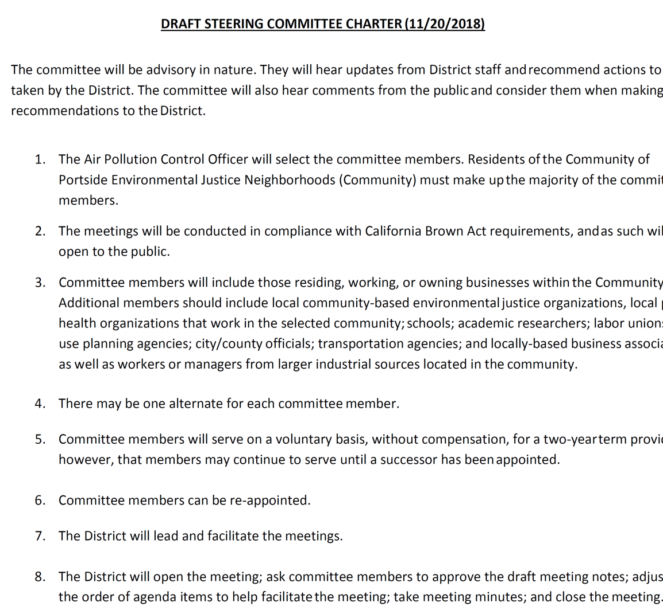
recommendation
Create a Working Group comprised of diverse Community Steering Committee Members to propose elements and update the Portside Steering Committee Charter.
Presentation of recommendations at December Steering Committee Meeting

