Slide 1
Highlights on Statewide Strategies Benefitting Communities
Portside Environmental Justice Neighborhoods
Steering Committee Meeting
April 23, 2019

Slide 2


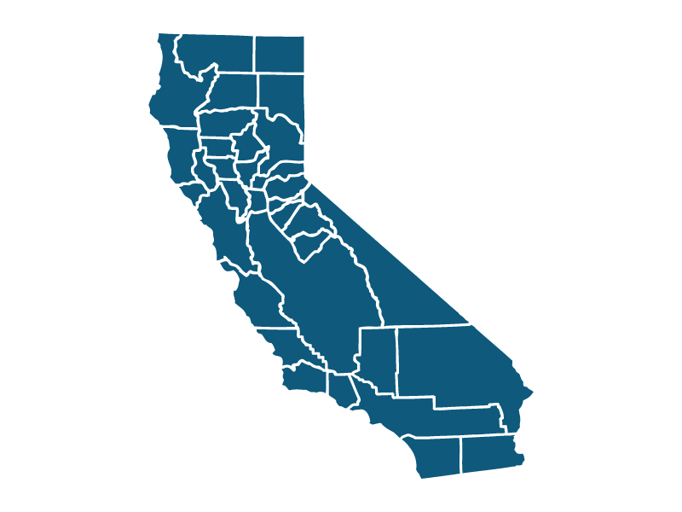









Air Quality Agencies
Federal
State
Local
U.S. EPA
CARB
Local Air Districts
Sets/enforces national air quality standards. Regulates interstate transportation.
Regulates mobile sources of air pollution, greenhouse gases, and consumer products.
Regulate stationary and
local sources of air pollution.
Trains
Ships
Planes
Cars
Trucks
Buses
Factories
Refineries
Residential woodstoves

Slide 3
Existing Regulations and Control Measures
Ports
Commercial
Harbor Craft
Cargo Handling Equipment
Rail
Mobile On-Road
Truck and Bus Regulation
Other Toxics
Chrome Plating Control Measure
Composite Wood Control Measure
Drayage Trucks
Heavy-Duty Vehicle Inspection Program
Mobile Off-Road
Off-Road Diesel Vehicle Regulation
Small Off-Road Engines
Drayage Trucks
Cargo Handling Equipment
Truck Idling
Control Measure
Shore Power
Ocean-Going
Vessels Fuel Rule
Transport Refrigeration Unit

Slide 4
Statewide Toxic Health Risks
Increased Cancer risk per million residents
Diesel Particulate
6 Toxic Air Contaminants

Slide 5
Statewide Black Carbon
1968-2000 Waste burning bans, cleaner fuels and other health measures
3-Year Moving Average BC (μg/m³)
2006 CARB Ultra-Low Sulfur Diesel Fuel
2011 Truck and Bus Regulation

Slide 6
Fine Particles (PM_{2.5}) in San Diego County
2001 Truck engine emissions standards
CAAQS = 12 µg/m³
CARB ADAM Air Quality Database

Slide 7
CARB emissions reduction strategies

Slide 8
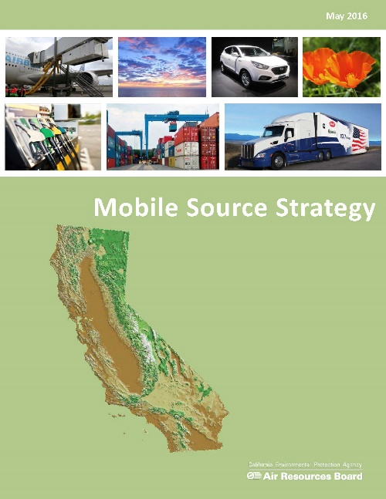



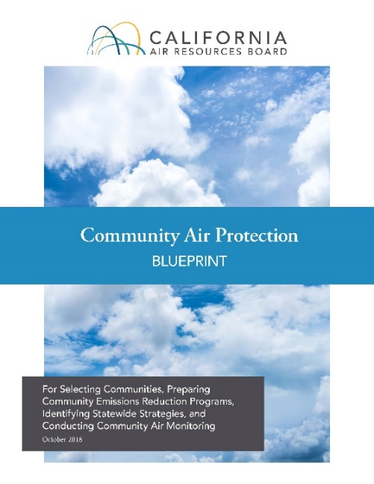
Recent Plans
All dates for proposed rules
are tentative and subject to change

Slide 9

Proposed On-Road Mobile Source Measures
Expected Board Consideration/Adoption – Implementation Begins
2018
2020
2025
2030
Innovative Clean Transit
Amendments to Smoke Inspection Programs
Heavy-Duty On-Board Diagnostic Regulations
Advanced Clean Local Trucks
Advanced Clean Cars 2
Heavy-Duty Inspection and Maintenance
Zero Emission Drayage Trucks

Slide 10





Proposed Off-Road Mobile Source Measures
Expected Board Consideration/Adoption – Implementation Begins
2018
2020
2025
2027
Ships At-Berth Amendments
Zero Emission
Transport Refrigeration Units
Small Off-Road Engines
Reduced Idling at Rail Yards
Commercial Harbor Craft Amendments
Zero Emission Cargo Handling Equipment
Emissions Reductions from Non-Preempted Locomotives

Slide 11
Additional Proposed Control Measures
Chrome Plating Control Measure Amendments
Composite Wood Products Control Measure Amendments
Commercial Cooking Suggested Control Measure
Expected Board Consideration Date= TBD

Slide 12
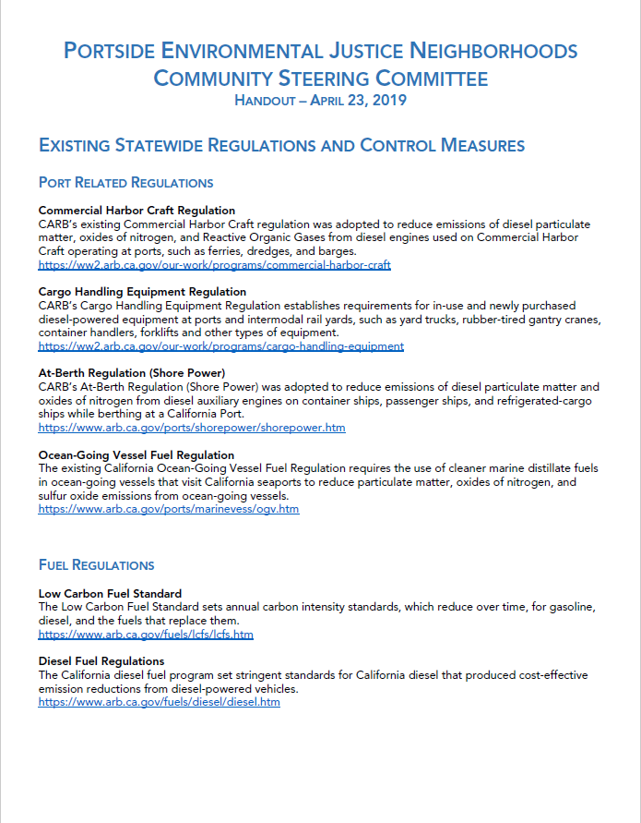
Handout

Slide 13
Contact Us
Liliana Nuñez
Office of Community Air Protection, CARB
Liliana.Nunez@arb.ca.gov or 626-350-6561
Melissa Niederreiter, Community Liaison
Office of Community Air Protection, CARB
Melissa.Niederreiter@arb.ca.gov or 916-323-6576

