Slide 1
San Diego International Border Community Steering Committee
Comité Directivo de la Comunidad Fronteriza Internacional de San Diego
San Ysidro & Otay Mesa East
April 20, 2022 // 20 de abril de 2022

Slide 2


How to use Zoom // Cómo Usar Zoom
Please select your language of choice (you must select one option)
Debe seleccionar el idioma de su preferencia (Tiene que escoger un idioma)

Slide 3
Agenda// Agenda
Welcome Remarks// Bienvenida
  Review Agenda// Revision de la Agenda
  Roll call CSC members// Lista de asistencia de miembors del Comité
  General updates// Actualizaciones generales
Community Boundaries// Límites de la Comunidad
Air Quality 101// Introducción a la Calidad del Aire
Steering Committee Charter// Estatuto del Comité Directivo
Public Comment// Comentarios Publicos
  For items not on the agenda (3 minutes per speaker)// Para puntos no incluídos en la agenda (3 minutos por participante)
Closing Remarks// Mensaje de Cierre
Adjourn// Cierre de Reunión

Slide 4
II. Community Boundaries
Límites de la Comunidad

Slide 5
Air Quality Research// Investigación de la calidad del aire
Partnering with CARB and local community organizations to obtain more comprehensive data// Asociarse con organizaciones comunitarias locales para obtener datos más completos
Air monitoring sites were placed to measure air quality// Se colocaron sitios de monitoreo del aire para medir la calidad del aire
Community demographics and pollution burden were analyzed// Se analizó la información demográfica y la carga de contaminación a la comunidad
Notes:
To have a more complete understanding of air quality and its impacts on the community, APCD has conducted air quality monitoring at the San Ysidro Fire Station and Donovan State Prison. We are also working on establishing a third air quality monitoring site at the CHP facility in Otay Mesa.
APCD is also partnering with the California Air Resources Board; community organizations, such as Casa Familiar, who has advocated for improved air quality in the community for many years; and with San Diego State University’s School of Public Health, who has been involved in conducting health and air quality research in the international border community for many years.
In addition, APCD has looked at the community demographics and pollution burden for the community based on CalEnviroScreen.

Slide 6
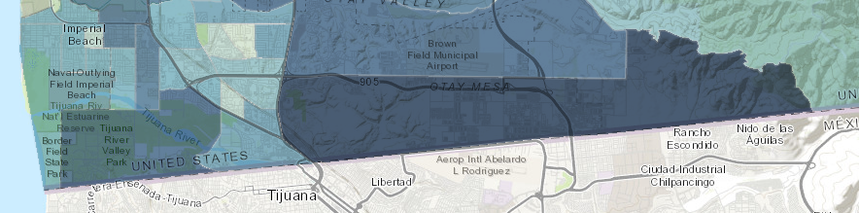

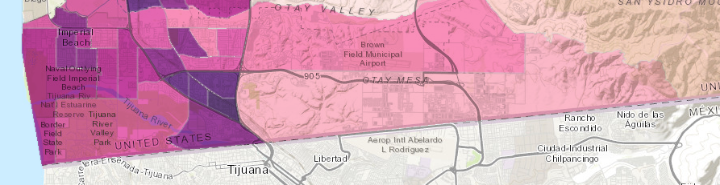
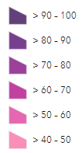
Pollution
Burden// Carga de Contaminación
Population Characteristics// Características de la Población
Notes:
Pollution Burden: PM 2.5, DPM, Drinking Water Contaminants, Children’s Lead Risk from Housing, Pesticide use, Toxic Releases from Facilities, Traffic Impacts, Cleanup Sites, Groundwater Threats, Hazardous Waste, Impaired Waters, Solid Waste Sites
Population Characteristics: Asthma, Cardiovascular Disease, Low Birth Weight, Education, Housing Burden, linguistic Isolation, Poverty, Unemployment

Slide 7
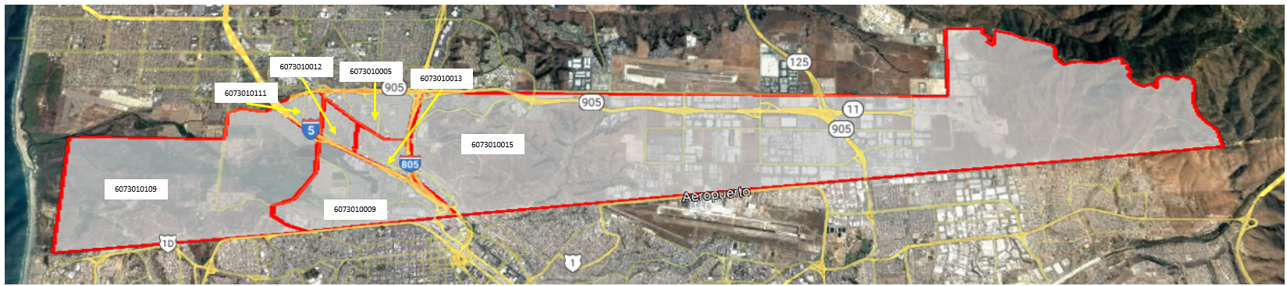
Community Boundaries// Limites de la Comunidad

