Slide 1
Welcome!
We will get started shortly.
¡Bienvenida!
Comenzaremos en breve.

Slide 2
INTERNATIONAL BORDER COMMUNITY
COMUNIDAD FRONTERIZA INTERNACIONAL
Community Steering Committee/ Comité Directivo Comunitario
September 18, 2024
18 de sebtiembre de 2024
Distrito de Control de Contaminación del Aire del Condado de San Diego

Slide 3
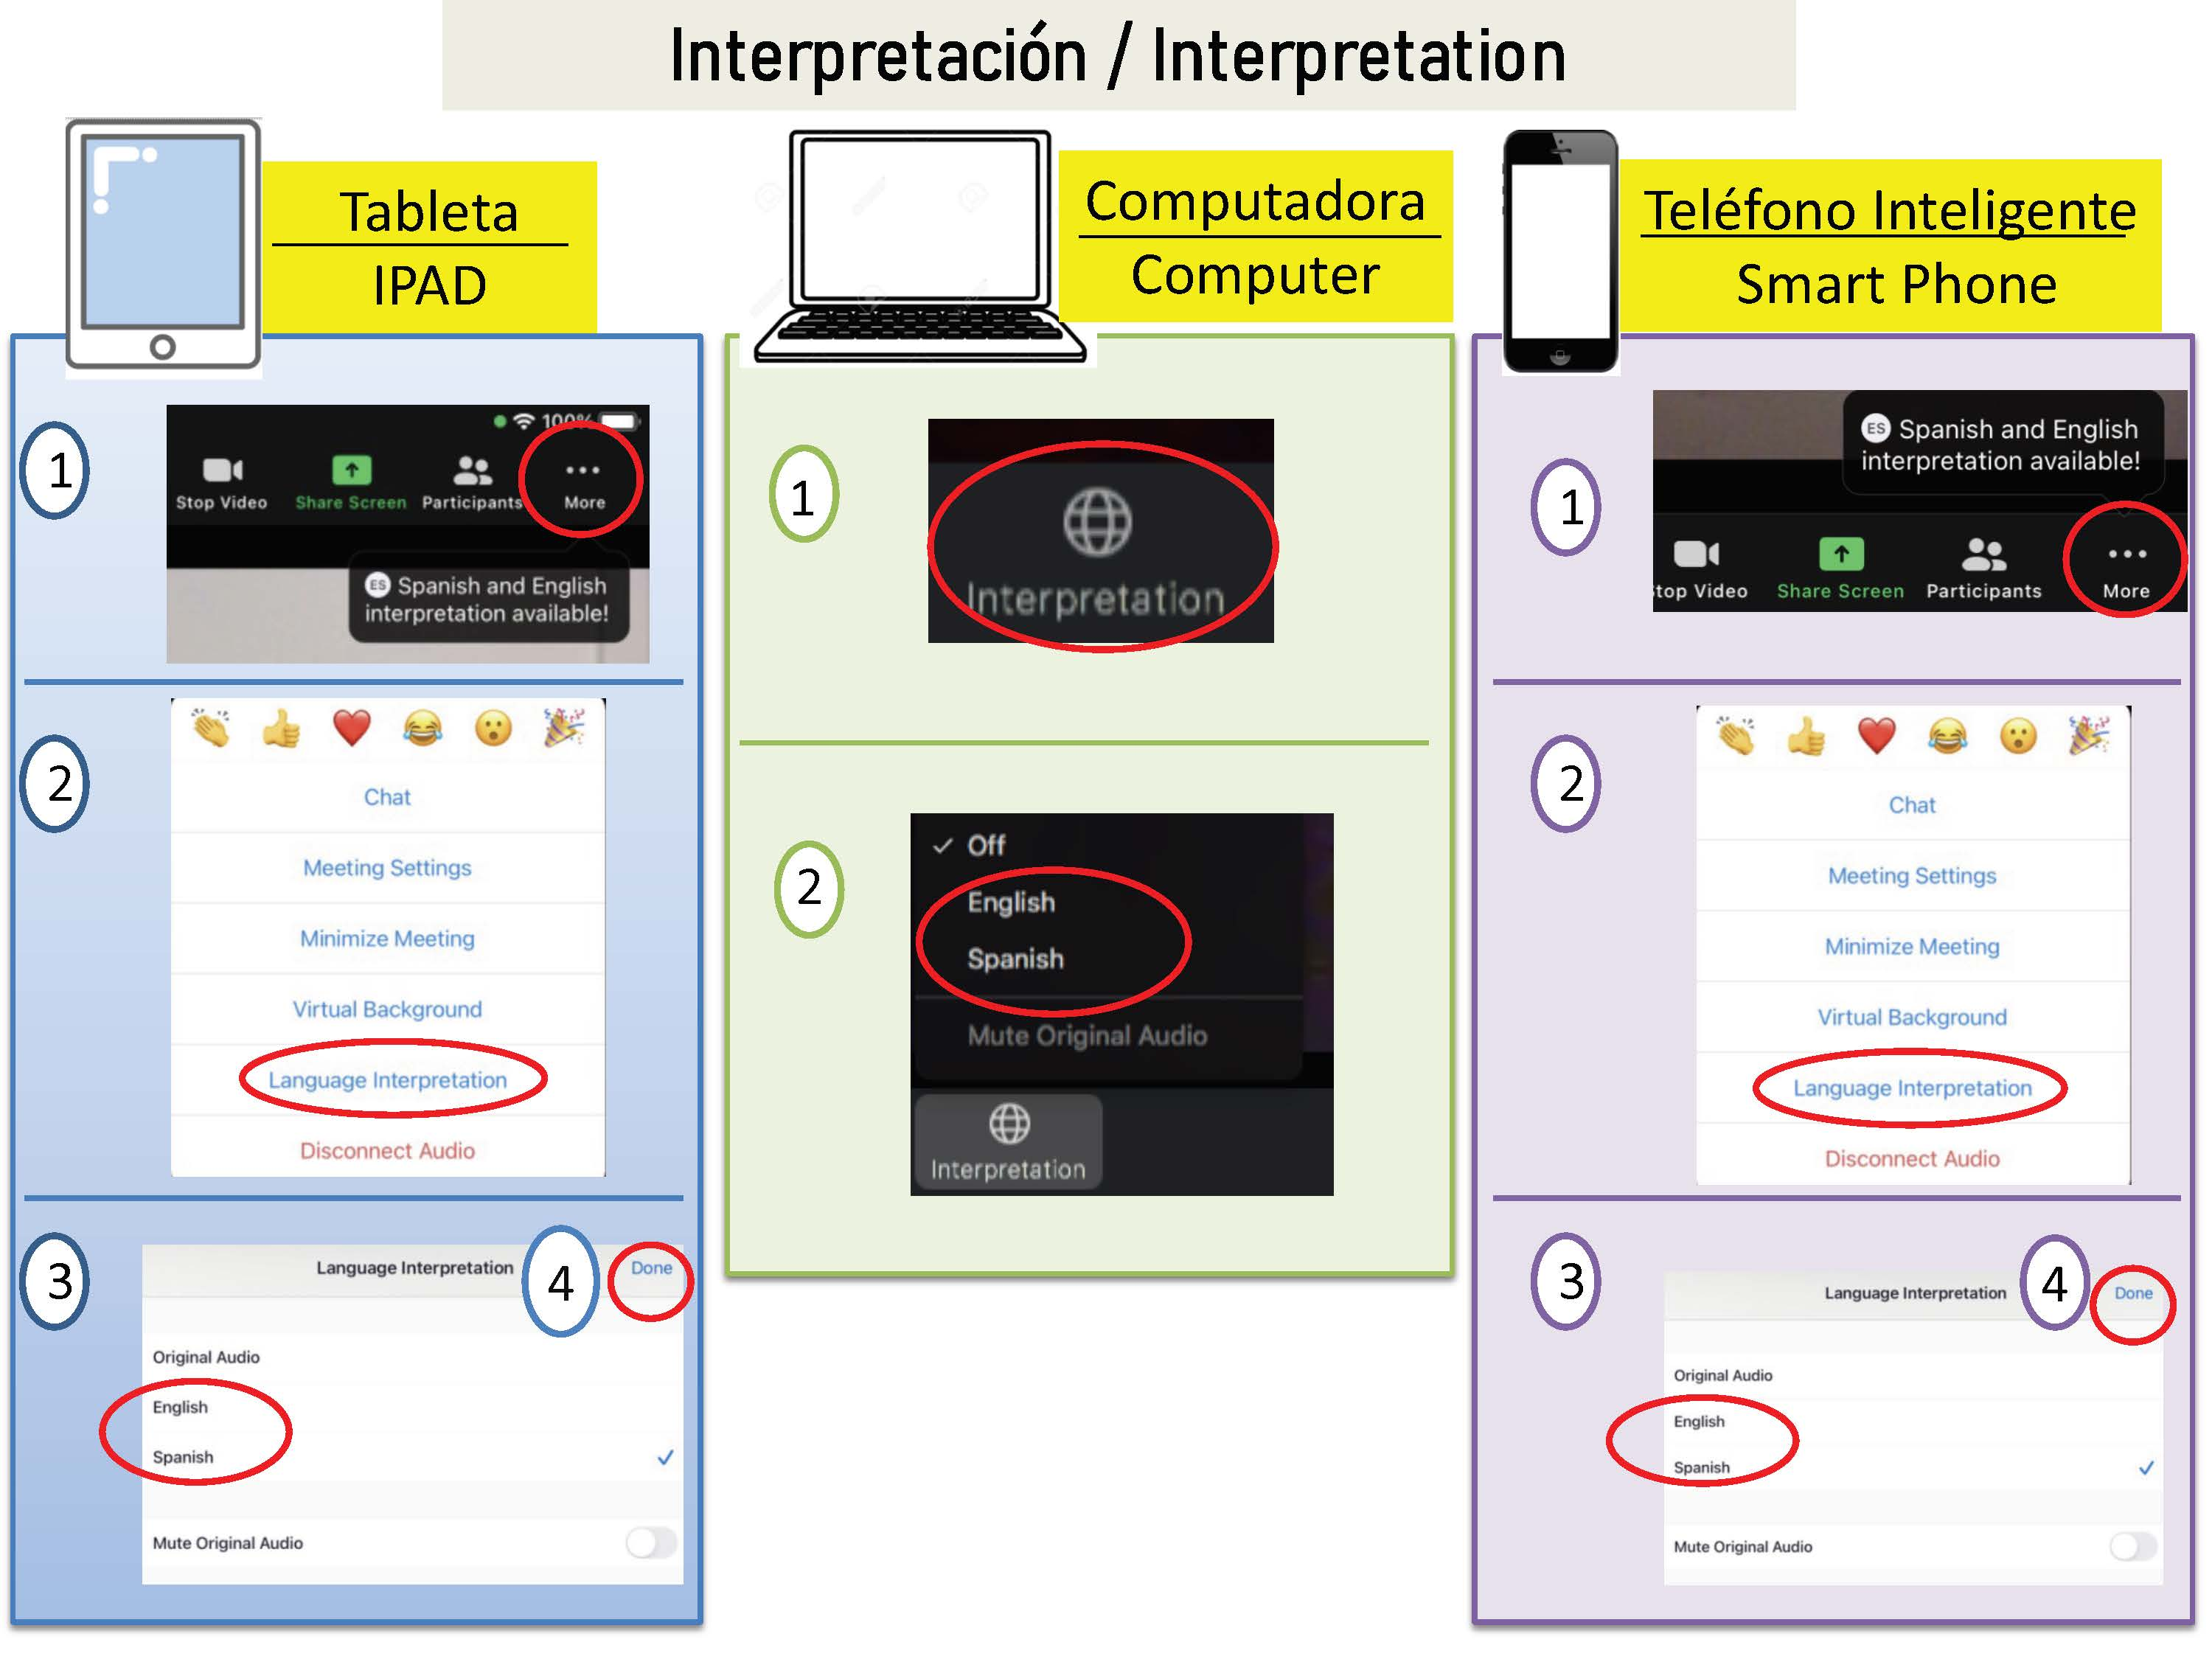
Interpretation Interpretación

Slide 4
Agenda
Orden del Día
Welcome & Updates
Presentation: City of San Diego Tree Program
Update: Tijuana River Valley Odor
Presentation & Feedback: AB 617 Incentives
Public Comments
Closing Remarks
Adjourn
Bienvenida y Actualizaciones
Presentación: Programa de Plantación de Arboles de la Ciudad de San Diego
Actualización: Actualizaciones del Valle del rio Tijuana
Presentación y Oportunidad para Comentarios: Fondos de Incentivo AB 617
Comentarios del Público
Comentarios de Clausura
Clausura de la Reunión

Slide 5
Presentation: City of San Diego Tree Program
Presentación: Programa de Plantación de Arboles de la Ciudad de San Diego

Slide 6
Update: Tijuana River Valley
Actualizaciónes: Valle del rio Tijuana

Slide 7
The County’s Hazardous Incident Response Team in coordination with San Diego State University researchers and the Robotic Emergency Deployment Team from Austin, TX, evaluated recent concerns in South County related to suspected presence of hydrogen cyanide near the Tijuana River.
This evaluation concluded that there were no immediate threat to life or safety
El Equipo de Respuesta a Incidentes Peligrosos del Condado, en coordinación con investigadores de la Universidad Estatal de San Diego y el Equipo de Despliegue de Emergencia Robótica de Austin, Texas, evaluaron las preocupaciones recientes en el sur del condado relacionadas con la presunta presencia de cianuro de hidrógeno cerca del río Tijuana.
Esta evaluación concluyó que no existía una amenaza inmediata para la vida o la seguridad.
Notes:
The San Diego County Air Pollution Control District (SDAPCD) continues to document strong odors impacting South Bay communities impacting residents’ quality of life. While compounds associated with these odors may cause adverse health effects, such as headaches and nausea, preliminary data does not indicate an immediate threat to life. We want to reassure the public that this is a high priority issue, and we will continue collaborating with partner agencies. For timely updates on the actions taken by SDAPCD in response to these air quality concerns, please visit the Tijuana River Valley (sdapcd.org) webpage.
We would like to also highlight that different news outlets reported that a group of researchers from San Diego State University and UCSD reported finding elevated levels of hydrogen cyanide (which is a chemical compound that could be lethal in high quantities). We want to share that the County Hazardous Incidence Response Team was deployed to assess this situation and was able to confirm that there was no threat to life or safety from hydrogen cyanide in the air. This was clarified with the research group and with the media and we wanted to reiterate this message to help make others aware.

Slide 8
SDAPCD Monitoring Update
SDAPCD Actualización de Monitoreo

Slide 9
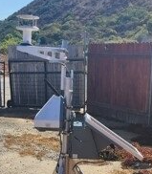
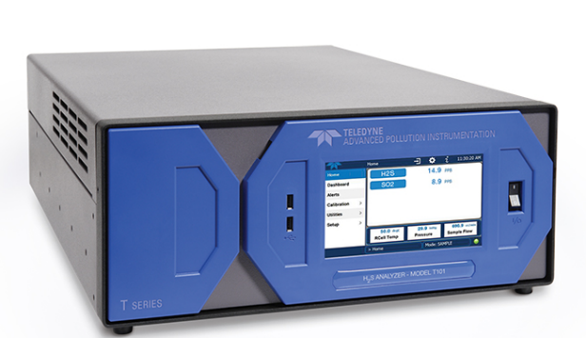
Background
Antecedentes
Teledyne T101
  Reference instrument
AQ Mesh Sensor
Notes:
The District was able to secure an EPA grant to procure six AQ Mesh sensors and one Teledyne T101 analyzer to primarily track hydrogen sulfide levels over time, which is the main odorous component of untreated sewage in and around the Tijuana River Valley. The AQMesh sensors operate on a solar/ battery system which allow us to deploy them where we don't have access to power and they are connected to a cellular network to transmit data 24/7.
The Teledyne T101 analyzer will be used as a reference instrument to apply any needed corrections to the sensor data and will be deployed in San Ysidro.
Both instruments can operate 24/7 and provide hourly measurements.
The original goal of this project was for trend analysis to better inform the community of odor patterns related to meteorological conditions. However, as the reported intensity and frequency of the odors has increased over the summer, the District shifted the design of this study and has greatly accelerated the process to provide more robust and quantitative data to inform public health officials.

Slide 10
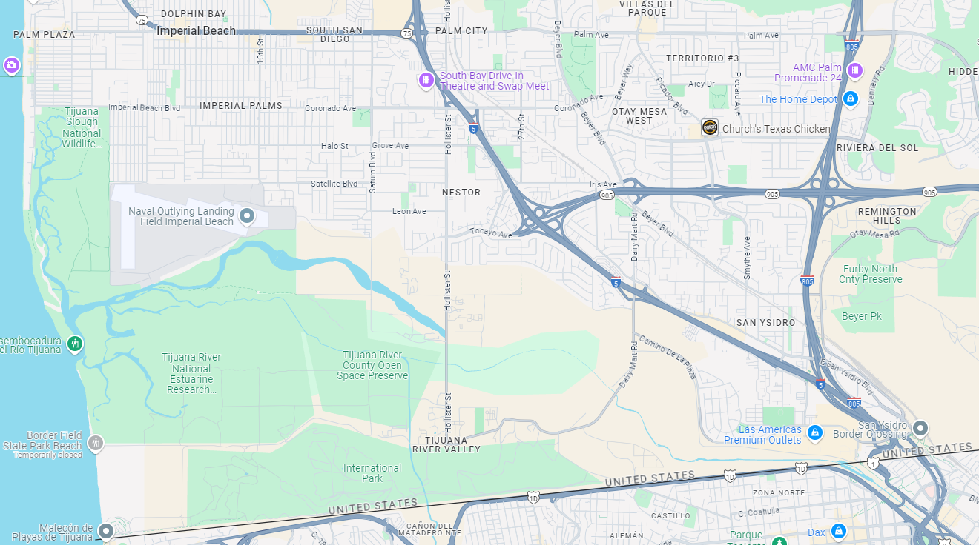
Sampling Locations/ Lugares de Muestreo
Imperial Beach Pier
Imperial Beach City Hall
Operational/Operacional
Work in progress/ Trabajo en curso
SD Fire Station #29
International Wastewater Treatment Plant
TJ River Valley Campground
Notes:
This map shows the locations of where we are currently monitoring, in blue, and plan to monitor, in orange.
Initially, all six sensors were deployed at the San Diego Fire Station #29 in San Ysidro for testing and to be able to establish how different the measurements were from all the different sensors and how well they tracked one another.
At this time, we have also deployed some of these sensors to the Imperial Beach Pier, TJ River Valley Campground and the International Wastewater Treatment Plant. We are also nearly finished with procuring the necessary infrastructure to deploy one at the Imperial Beach City Hall/ Fire Station location, and are researching a potential location in the community of Nestor.
Backpocket
During that time we also worked on identifying feasible locations for the sensors while also incorporating input from the community. We subsequently approached potential partners and initiated work on land accessibility agreements for the different locations, which also include legal, maintenance, and safety considerations.
Once the fall protection has been installed at that location, we can install a sensor there.

Slide 11
H₂S Standard Levels
H₂S Niveles Estándard
CARB & CA Office of Environmental Health Hazard Assessment
  Acute Reference Exposure Level (1 hour average): 30 parts per billion
    Health Effects: Headaches, nausea, physiological responses to odor
National Institute for Occupational Safety and Health
  Immediately Dangerous to Life or Health: 100 parts per million (100,000 parts per billion)
CARB & Oficina de Evaluación de Riesgos para la Salud Ambiental de CA
  Nivel de exposición aguda de referencia (promedio de 1 hora): 30 partes por mil millones
    Efectos sobre la salud: dolores de cabeza, náuseas, respuestas fisiológicas al olor.
Instituto Nacional de Seguridad y Salud Ocupacional
  Inmediatamente Peligroso para la Vida o la Salud: 100 partes por million (100,000 parts por mile millones)
Notes:
Before I share some of our preliminary data, I would like to point out that there are a number of standards and reference levels for hydrogen sulfide.
The California Air Resources Board, or CARB, and the California Office of Environmental Health Hazard Assessment’s standard is based on one-hour average level set at 30 parts per billion.
The National Institute for Occupational Safety and Health has set the immediately dangerous to life or health level at 100 parts per million, which is equal to one hundred thousand parts per billion.
We are in communication with CDC's Agency for Toxic Substances and Disease Registry, California Department of Public Health, and the County of San Diego and we have provided our preliminary data to them and will continue to do so to get assistance in analyzing the data and potential impacts to the community.
While hydrogen sulfide may cause adverse health effects, such as headaches and nausea, based on data available to us at no time have we seen levels that would approach the NIOSH standard of one hundred thousand parts per billion – the level at which there’s an immediate threat to life or health. However, the current levels continue to negatively impact people’s quality of life in the affected communities.

Slide 12
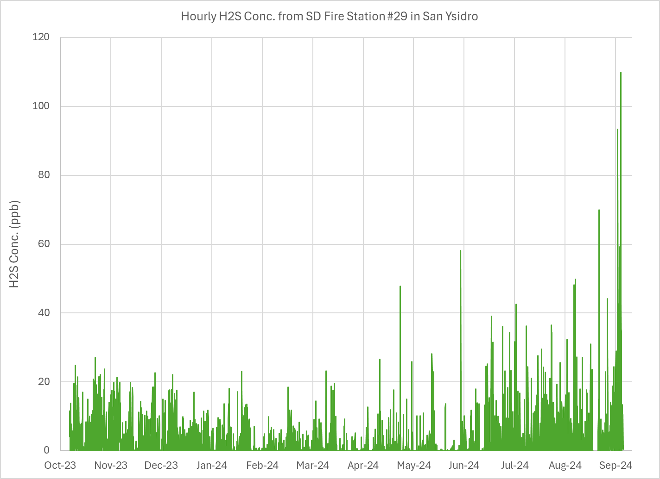
Preliminary Data/ Datos Preliminares
San Ysidro
  Oct. 16, 2023 to Sep 9, 2024
This data is for trend analysis only
San Ysidro
  16 de octubre 2023 al 9 de septiembre de 2024
Estos datos son solo para análisis de tendencias.
Notes:
This graph displays the preliminary data from one of the sensors from the time it was deployed at the San Diego Fire Station #29 in San Ysidro.
All the sensors show the same trend. We are seeing the following trends in the data so far:
Higher concentrations are seen throughout the nighttime hours and lower concentrations during the day
The concentrations in the last three months are higher than the preceding several months
The levels this past weekend are the highest values we have seen in the nearly 11 months of collecting data

Slide 13
SDAPCD’s Ongoing Actions: Monitoring, Communications and Collaborations
Acciones en Curso del SDAPCD: Monitoreo, Comunicaciones y Colaboraciones
Share data with other health agencies to keep them informed
Collaborate with the research teams from UCSD and SDSU to learn more about hydrogen sulfide levels in the Tijuana River Valley
Collaborate with the Agency for Toxic Substances and Disease Registry to get assistance in analyzing the sensor data and potential impacts to the community.
Compartir datos con otras agencias de salud para mantenerlas informadas
Colaborar con equipos de investigación de UCSD y SDSU para aprender más sobre niveles de sulfuo de hidrógeno en el Valle del Rio Tijuana
Colaborar con la Agencia para Sustancias Tóxicas y Registro de Enfermedades para obtener ayuda en el análisis de los datos de los sensores y los posibles impactos en la comunidad.

Slide 14
SDAPCD’s Ongoing Actions: Monitoring, Communications and Collaborations
Acciones en Curso del SDAPCD: Monitoreo, Comunicaciones y Colaboraciones
Continue providing informational updates on our monitoring activities
Post odor advisories on our website to alert the community of strong odors and address potential safety concerns
Continuar brindando actualizaciones informativas sobre nuestras actividades de monitoreo
Publicar avisos sobre olores en nuestro sitio web para alertar a la comunidad sobre olores Fuertes y abordar posibles preocupaciones de seguridad

Slide 15
SDAPCD’s Ongoing Actions: Monitoring, Communications and Collaborations
Acciones en Curso del SDAPCD: Monitoreo, Comunicaciones y Colaboraciones
Develop a public information campaign to provide the public with relevant, accurate and timely information on air quality, in partnership with school districts, cities, and the County (Board Directive)
SDAPCD will work with the Office of Emergency Services for the County and the City to provide emergency alters and rapid response in case of an imminent threat to public health from air quality issues. (Board Directive)
Desarrollar una campaña de información pública para brindar al público información relevante, precisa y oportuna sobre la calidad del aire, en asociación con los distritos escolares, las ciudades y el condado (Directiva de la Junta)
El SDAPCD trabajará con la Oficina de Servicios de Emergencia del Condado y la Ciudad para brindar alternativas de emergencia y una respuesta rápida en caso de una amenaza inminente a la salud pública debido a problemas de calidad del aire. (Directiva de la Junta)

Slide 16
SDAPCD Compliance Update
Actualización de Cumplimiento del SDAPCD

Slide 17
Tijuana river sewer gases causing hydrogen sulfide smell
Wake up with headaches and nausea.
Had to bring my wife to the Balboa ER this morning because the air smells and tastes toxic. It’s unbelievable.
There is a strong sewage odor in the air.
The sewage odor has become unbearable and Imperial Beach.
Smells like sewage
The smell has become nauseating
The air in imperial beach has been unbearable for years, this year it’s so strong it’s causing chronic headaches for everyone in my household and coughs
Since July 19, 2024, we have received nearly 2,000 odor complaints from various communities surrounding the Tijuana River/ Desde el 19 de julio de 2024, hemos recibido cerca de 2,000 quejas por olores de diversas comunidades aledañas al Río Tijuana.
It stinks and the smell is so nauseating in the morning that even when we are deeply asleep the smell wakes us up as it’s extremely penetrating and unbreathable. We’re concerned that it may be toxic as well.
The smell is so bad it will wake you up from a dead sleep around 1am gasping for air.
Horrible smell
Kids are complaining of nausea
Strong sewer order very toxic have to close windows
Very strong odor
The sewage smell makes me sick.
This morning the sewage stink was disgusting.
Notes:
Since July 19, 2024 we have received over 2,000 odor complaints from South Bay communities. This is the highest number of complaints we have ever received regarding a source. For additional context, for the past several years we received, on average, a total of 800 complaints per year
This slide shows some of the concerns reported by the communities impacted by these odors.
We want to acknowledge that the conditions causing these concerns are unacceptable. Nobody should be exposed to this type of odors.
We have documented violations of local and State air quality regulations, which resulted in enforcement actions against International Boundary and Water Commission (or IBWC) and their contractor Veolia. We will continue to enforce our laws to the full extent of our jurisdiction.

Slide 18

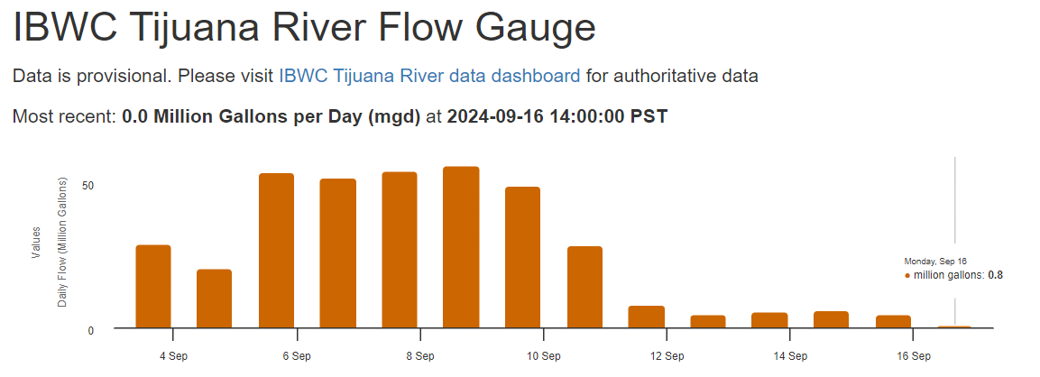
Update Reported by IBWC
Actualización Reportada por el IBWC
Data Source: https://tijuanariver.trnerr.org/IBWC.php
Medidor de Flujo del Rio Tijuana del IBWC
Datos son provisionales. Visite el panel de datos del rio Tijuana del IBWC para obtener datos autorizados.
Notes:
Another critical problem has been that the sewage that is being directed to the TJ river is not being treated by IBWC.
This slide shows data published by IBWC regarding the amount of untreated flow going to the Tijuana River.
According to IBWC, earlier this month there were about 90 million gallons of untreated flows per day going to the river, but there should NOT be any flow going into the river.
IBWC reported it is monitoring the flows and its data is available to the public. The QR code provides access to the data
According to IBWC, as of last week, the majority of the flow has been diverted to the wastewater treatment plant in Mexico and has seen a significant drop in sewage flow .
The District Compliance Division continues to investigate to respond to complaints, document odors, and verify if this trend continues.

Slide 19
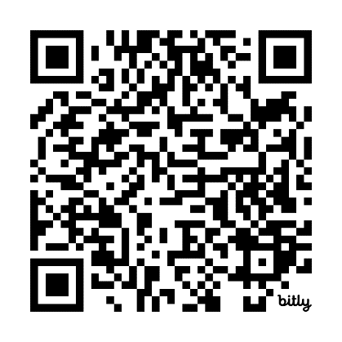
SDAPCD Notices of Violation Public Nuisance
SDAPCD Aviso de Infracción Molestia Pública
On July 29, 2024, SDAPCD issued a Notice of Violation to IBWC and their contractor Veolia for creating a public nuisance.
Subsequently, on August 30, 2024, SDAPCD issued another NOV to IBWC and Veolia since compliance with nuisance regulations has not been achieved.
El 29 de julio de 2024, SDAPCD emitió un Aviso de Infracción a IBWC y a su contratista Veolia por crear una molestia publica.
Posteriormente, el 30 de Agosto de 2024, SDAPCD emitió otro Aviso de Infracción a IBWC y Veolia ya que no se ha logrado cumplimiento de las regulaciones sobre molestias.
19
Notes:
On July 29, 2024, SDAPCD issued a Notice of Violation to IBWC and their contractor Veolia for creating a public nuisance. Subsequently on August 30, 2024, SDAPCD issued another NOV to IBWC and its contractor, Veolia since we have not been able to document compliance with public nuisance regulations.
The Notices of Violation were issued because we have been documenting strong odors that are negatively impacting communities, which is a public nuisance and a violation SDAPCD's Rule 51 and state law.
While this is still an ongoing investigation, we have determined that the public nuisance is primarily due to a combination of outdated infrastructure and inadequate maintenance, both of which fall under the responsibility of the IBWC and Veolia.
This slide includes a QR code for a webpage that was specifically created to provide transparent and timely updates on these actions.

Slide 20
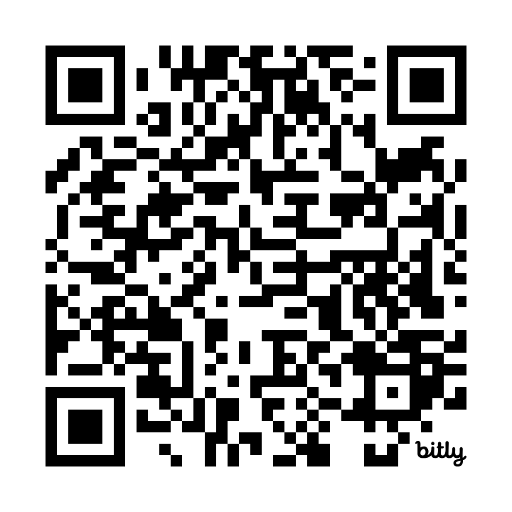
SDAPCD’s Ongoing Actions: Compliance
Acciones en Curso del SDAPCD: Cumplimiento
Mantenerte informado https://bit.ly/TJOdorInvestigation
Reunion con IBWC para establecer hitos específicos hacia el cumplimiento
Continuar nuestra investigación
Keep you Informed
Meet with IBWC to Establish Specific Milestones Towards Compliance
Continue our Investigation
Notes:
In terms of next steps, our top priority is to keep the public well-informed. We will maintain complete transparency regarding the scale of this issue and the resources required to address it. As mentioned earlier, we’ve created a webpage that will be regularly updated with the latest information on this investigation. We will also continue collaborating with other agencies, including the Water Board, County of San Diego, CARB, EPA, IBWC and others, all of which have a role in addressing this issue. As previously mentioned, this is a significant environmental issue that extends beyond air quality concerns. Therefore, closely working with other agencies is essential.
This month, we will be meeting with IBWC representatives to discuss the NOVs and better understand the steps they are taking to comply with air quality regulations. Based on the outcome of that discussion, we will assess and determine the appropriate next steps for enforcement.
Regardless of whether we continue to receive air quality complaints, our investigations will persist. Once we document a violation, our standard procedure is to continue the investigation until we verify compliance. Our inspectors are on the ground in the impacted communities multiple days per week to document any ongoing impacts.

Slide 21
Air Filters
Filtros de Aire
Notes:
Thank you, David. We’d like to briefly discuss how portable air purifiers can help mitigate odors by filtering out airborne contaminants that contribute to odors.
While we recognize that portable air purifiers are not a solution to the broader environmental crisis, they can offer temporary relief by improving indoor air quality in affected communities.

Slide 22
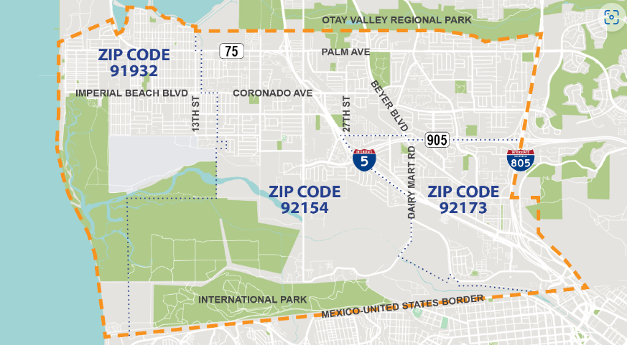
Update: Air Filters
Actualización: Filtros de Aire
County of San Diego has a pilot project that has distributed 411 filters
EPA grant of $100K in support of deploying indoor air purifiers to the community affected by sewage odors
Partnership with the County of San Diego to support their existing Air Purifier Pilot Program (Board Approved)
El condado de San Diego tiene un proyecto piloto que ha distribuido 411 filtros
Subvención de la EPA de $100 000 en apoyo a la implementación de purificadores de aire en interiores para comunidad afectada por los olores de las aguas residuales
Asociación con el condado de San Diego para apoyar su actual programa piloto de purificadores de aire (Aprobado por la Junta)
Notes:
The U.S. EPA has committed $100K in grant funding to SDAPCD to support deploying indoor air purifiers to the community affected by sewage odors to help provide some temporary relief.
In response to the ongoing Tijuana River Valley sewage crisis, in June 2024, the County Board of Supervisors allocated $100,000 in funding to provide free air purifies to homes in areas affected by ambient odors. In August 2024, the County coordinated registrations throughout the eligible area, as shown on the slide, and a randomized drawing from the registration pool to identify participants in the pilot program.
SDAPCD has identified an opportunity to partner with the County of San Diego through their existing Air Purifier Pilot Program to help deploy additional air purifiers as quickly as possible.
SDAPCD Board Approve and authorize SDAPCD to enter into an agreement with SD County to provide additional funding to the County’s air purifier pilot program. This partnership with the County would allow to more expeditiously deploy the indoor air filters to the affected community.

Slide 23
SDAPCD’s Ongoing Actions: Air Filters
Acciones en Curso del SDAPCD : Filtros de Aire
SDAPCD to develop a plan for SDAPCD to continue funding, procurement, and distribution of air purifiers, filters, and Personal Protective Equipment (PPE) (Board Directive)
Identifying other potential funding (i.e., AB 617 funds, grants, etc.)
SDAPCD desarrollará un plan para que SDAPCD continúe financiando, adquiriendo y distribuyendo purificadores de aire, filtros y Equipos de Protección Personal (EPP)(Directiva de la Junta)
Identificar otras fuentes de financiación potenciales (es decir, fondos AB 617 subvenciones, etc.)
Notes:
The Board also provided direction to develop a plan to continue funding and distributing air purifiers. We have pulled together our internal team to find the best way for SDAPCD to carry out this direction. We have some ideas for potential funding, including AB617 incentive funding, that we expect will be able to help with this effort. We would like to hear from the community any feedback they have on the County program to help us design something that works well and quickly for the affected residents.
The U.S. EPA has committed $100K in grant funding to SDAPCD to support deploying indoor air purifiers to the community affected by sewage odors to help provide some temporary relief.
In response to the ongoing Tijuana River Valley sewage crisis, in June 2024, the County Board of Supervisors allocated $100,000 in funding to provide free air purifies to homes in areas affected by ambient odors. In August 2024, the County coordinated registrations throughout the eligible area, as shown on the slide, and a randomized drawing from the registration pool to identify participants in the pilot program.
SDAPCD has identified an opportunity to partner with the County of San Diego through their existing Air Purifier Pilot Program to help deploy additional air purifiers as quickly as possible.
Recently, the SDAPCD Board Approved and authorized SDAPCD to enter into an agreement with SD County to provide additional funding to the County’s air purifier pilot program. This partnership with the County would allow to more expeditiously deploy the indoor air filters to the affected community.

Slide 24
Presentation & Feedback: AB 617 Incentives
Presentación y Oportunidad para Comentarios: Fondos de Incentivo AB 617

Slide 25
Historic Incentives
Incentivos Históricos
Allocated $85.6 million from the state over the last six years
Have contracted and/or paid out $42.5 million so far
Other projects – Port MOU, air filters
Have $36.8 million left to allocate
Se han asignado $85.6 millones por parte del Estado durante los últimos seis años
Se han contratado y/o pagado $42.5 millones hasta el momento
Otros proyectos – MOU del Puerto, filtros de aire
$36.8 millones restantes para asignar

Slide 26
Projects/ Proyectos
Portside $13.2 million | International Border $10 million | El Cajon $2.2 million
2 zero emission trucks funded through the ZE Truck Pilot Project ($500,000) | 2 heavy duty charging stations ($10 million) | 1 heavy duty charging station ($2.2 million)
1 repower of a marine vessel to cleaner diesel Tier 3 engines ($120,000)
4 heavy duty charging stations ($12.6 million)
Comunidad Portuaria $13.2 millones | Comunidad Fronteriza $10 millones | El Cajon $2.2 millones
2 camiones de cero emisiones financiados a través del Proyecto Piloto de Camiones ZE ($500,000) | 2 estaciones de carga para camiones pesados ($10 millones) | 1 estación de carga para camiones pesados ($2.2 millones)
1 repotenciación de un buque marino a motores diésel mas limpios Tier 3 ($120,000)
4 estaciones de carga para camiones pesados ($12.6 millones)

Slide 27
Are you in support of funding this project mix with the available funding?
¿Están a favor de financiar esta combinación de proyectos con los fondos disponibles?

Slide 28
Next Meeting
Próxima reunión
Next Meeting: October 16, 2024
(virtual via zoom)
Próxima Reunión: 16 de octubre 2024
(virtual por zoom)

